Slide 1
We are the Entertainment Industry’s Voice for Road Safety.
Recording Artists Against Drunk Driving®
Lesson 3: D.U.I Prevention Strategies

Slide 2
Founded in 1986 as Rockers Against Drunk Driving, RADD® advocates the use of designated drivers, rideshares, seatbelts and safe driving through full control behind the wheel, making responsible behavior the norm. RADD's messages are non-judgmental and positive.
Now Recording artists Against Drunk Driving, RADD® acts as
The Entertainment Industry’s Voice for Road Safety and is dedicated to saving lives and reducing injuries through edutainment.

Slide 3
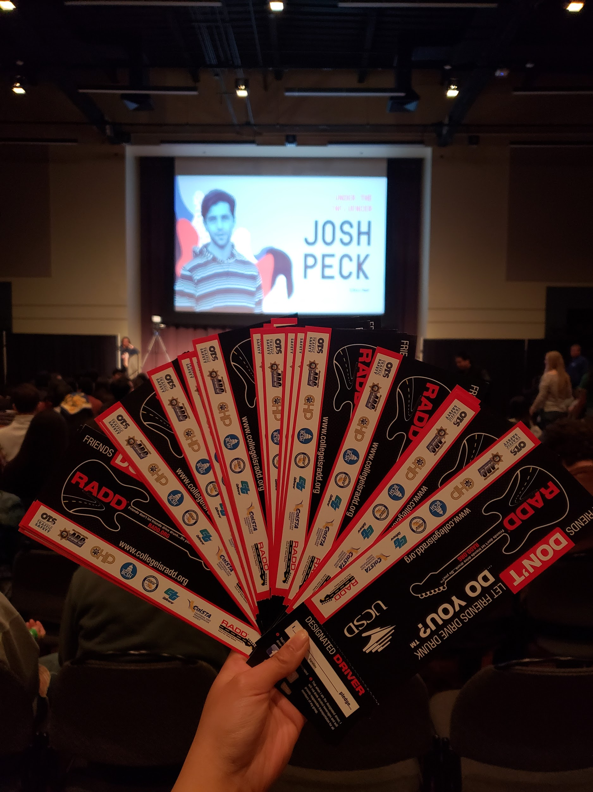
RADD® is a 501 c3 nonprofit, funded in California by the California Office of Traffic Safety (OTS). We implement education and DUI prevention strategies by traveling over 50,000 miles a year to 40+ college campuses throughout California!
RADD at UCSD’s Triton Fest event, “Under the Influencer with Josh Peck”.

Slide 4
RADD’s Message
We are a non-profit organization funded by music fans just like you who agree it’s just as important to get home safely and live to party another night as it is to enjoy a great show.
Eat – drink – work – party – love. But choose to do them all safely.
Our Promise
Friends don’t let friends drive drunk… Do you?® Step up with us to make your own pledge. Use a DD or call a ride share. Crash on a friend’s couch. Or get a room. Just don’t get on the road. Your lifestyle is your business — unless you take it on the road. Then its everybody’s business.
Notes:
4/21 Note: Taken from RADD’s homepage on website / “Our Promise”

Slide 5
Overview and Learning Objectives
In this lesson, we will go over D.U.I. prevention strategies, which will include:
Tips on planning ahead before going out
Tips on hosting a party where alcohol is involved
What is the purpose of this lesson?
The purpose of this lesson is to provide prevention strategies young adults can adopt in order to practice responsible drinking, prevent underage and binge drinking, and to prevent D.U.I.s.

Slide 6
Plan Before You Party
Before you go out for drinks, use our “Plan Before You Party” checklist to help you make safe decisions so you can enjoy your time out!
Leave the car at home, unless you’re the designated driver.
Know how you’ll be getting home safely.
Encourage safe and responsible behavior by preventing underage and binge drinking.
Encourage reasonable consumption, by consuming no more than one standard drink per hour (while consuming water and food in between).

Slide 7
Rideshare
Using rideshare services may be the most popular and convenient way of getting to and from your destinations when going out.
Before going out, have your rideshare app downloaded on your phone and sign in to your account. That way, when you’re ready to head home, you’ll be all set and just need to order a ride.

Slide 8
Designate a Driver
If you’re designating a driver, it is important that they stay sober at all times. A designated driver is not the person that is least drunk.
3 out of 4 people use designated drivers.
75% of people volunteer to be the designated driver so they can get home safely.
85% chose to ride with a sober driver for the same reason.
https://teens.drugabuse.gov/blog/post/designated-drivers-you-are-not-alone

Slide 9
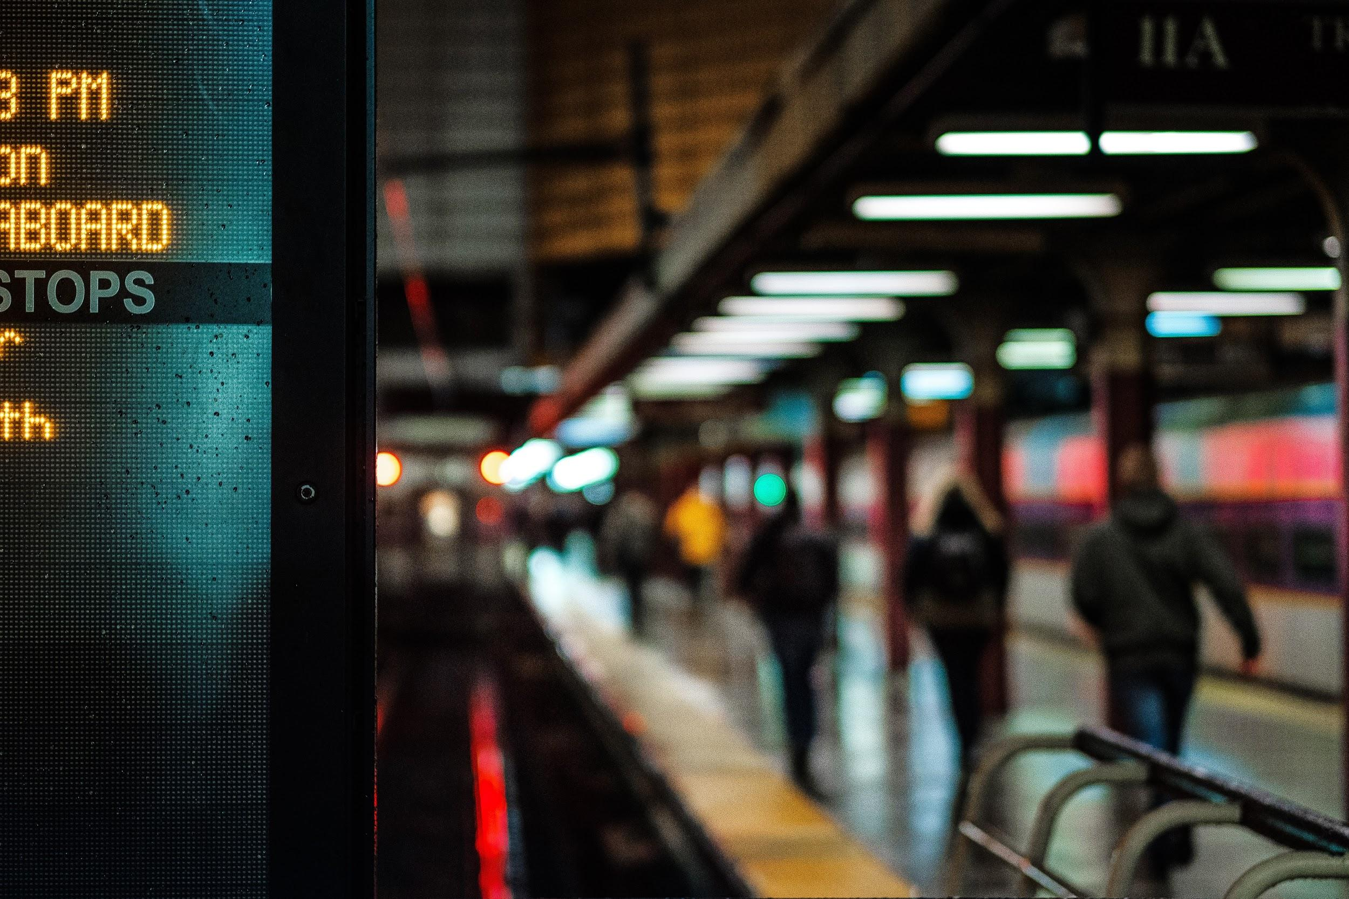
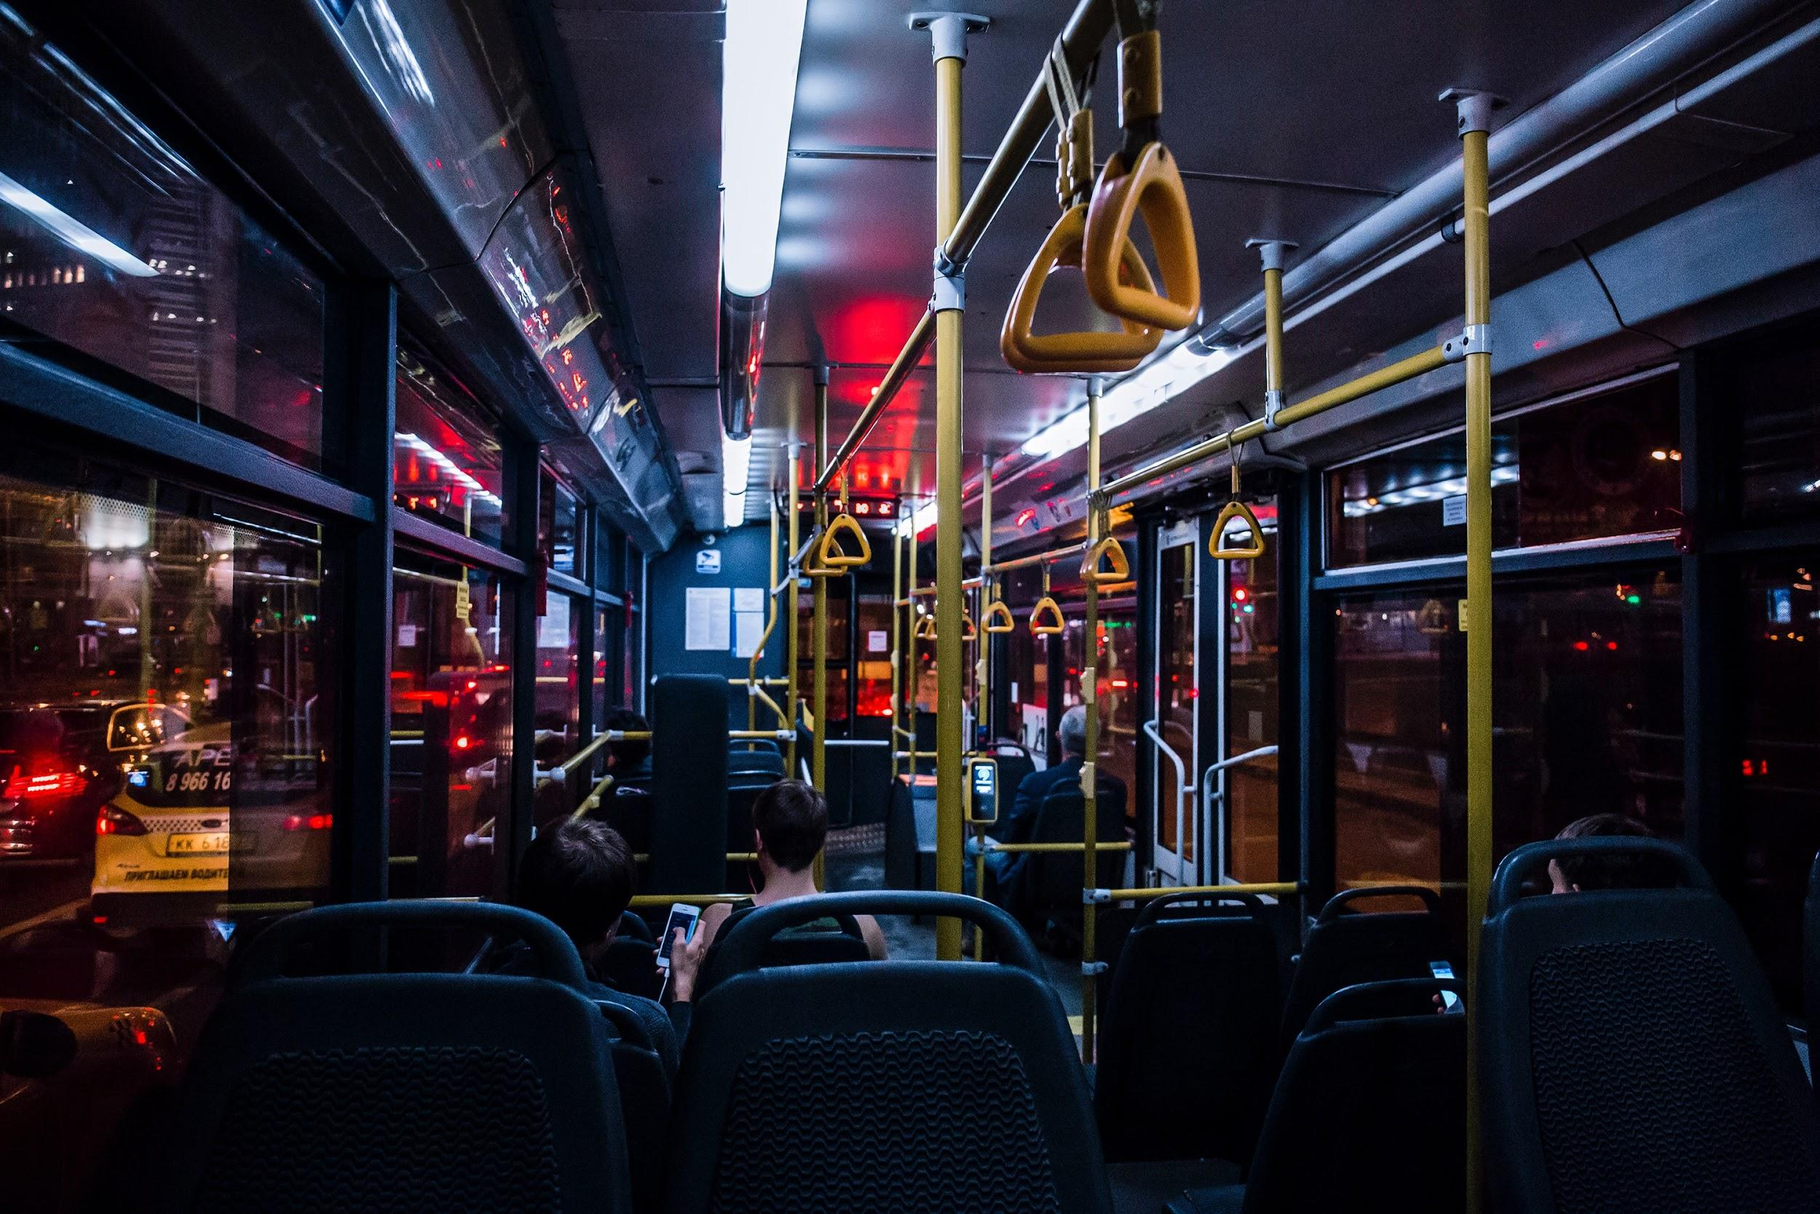
Public
Transportation
If you plan on using the bus or trolley, make sure you have a pass ready beforehand. Be familiar with the transportation schedule. Make a note on your phone app with the name of your stop and the times of the last two trains at that stop.

Slide 10
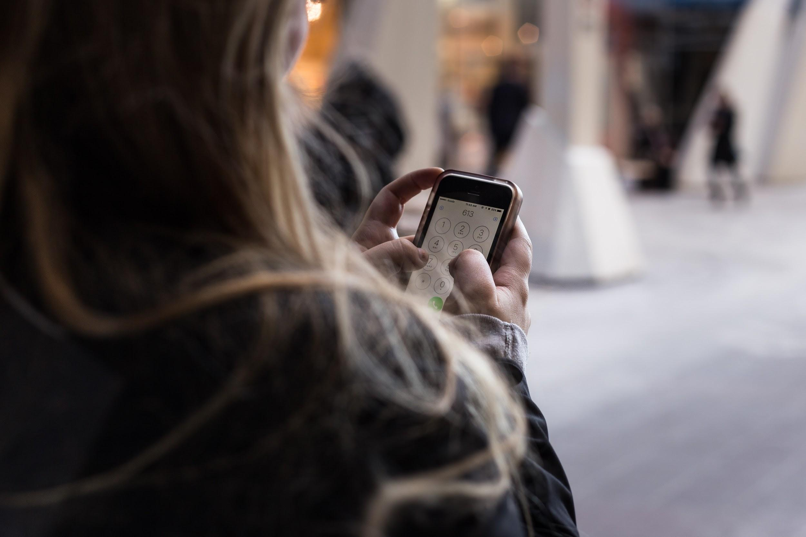
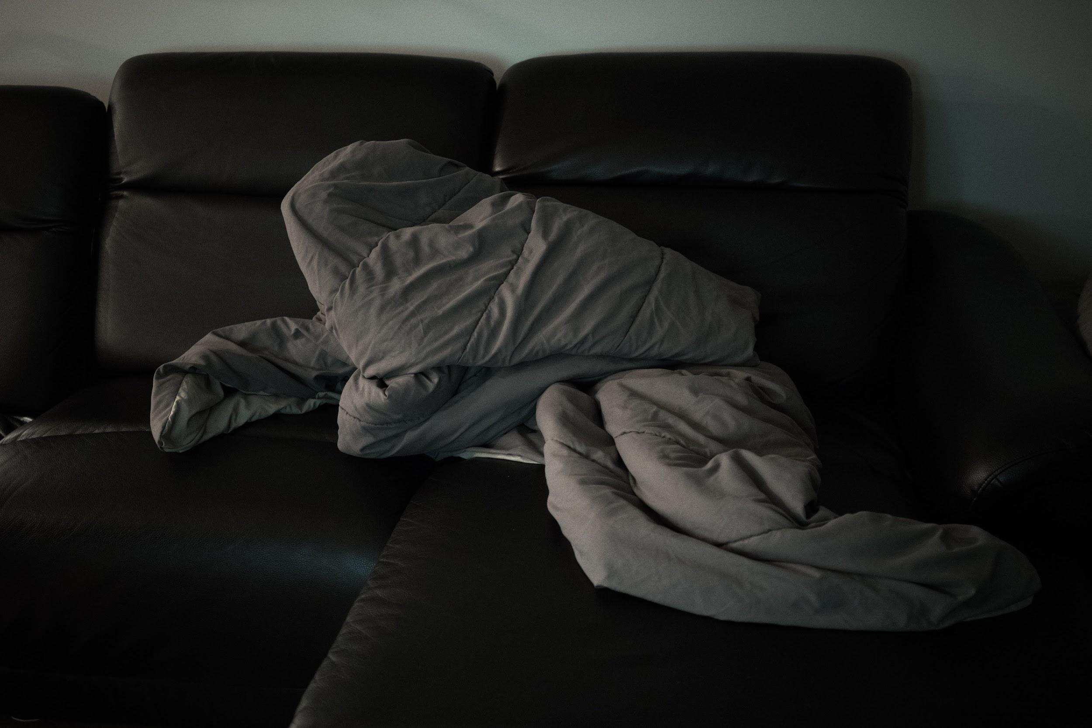
Ask a Friend
Consider calling a friend to pick you up and take you home or ask them if you can crash on their couch for the night.
RADD Tip: Thank your friend by treating them to lunch the next day, or by cleaning up the living room after your stay!

Slide 11
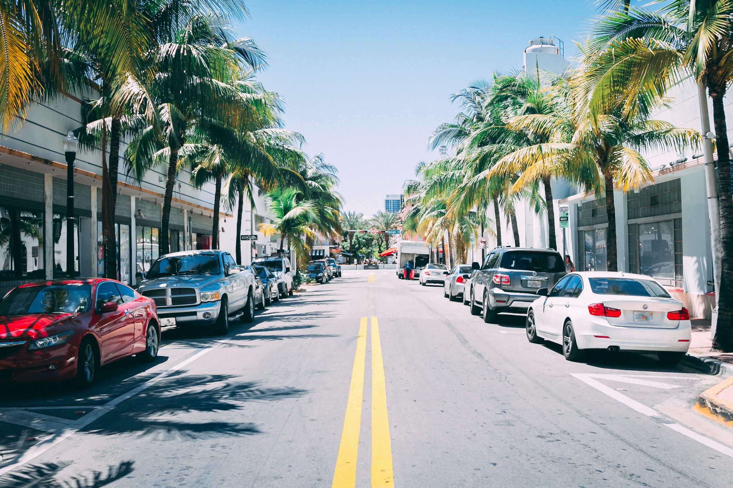
Leave Your Car
If you or your designated driver ends up drinking, leave your car parked overnight. Pick it up the next morning when you or the owner are sober and able to get behind the wheel.

Slide 12
Hosting a Party

Slide 13
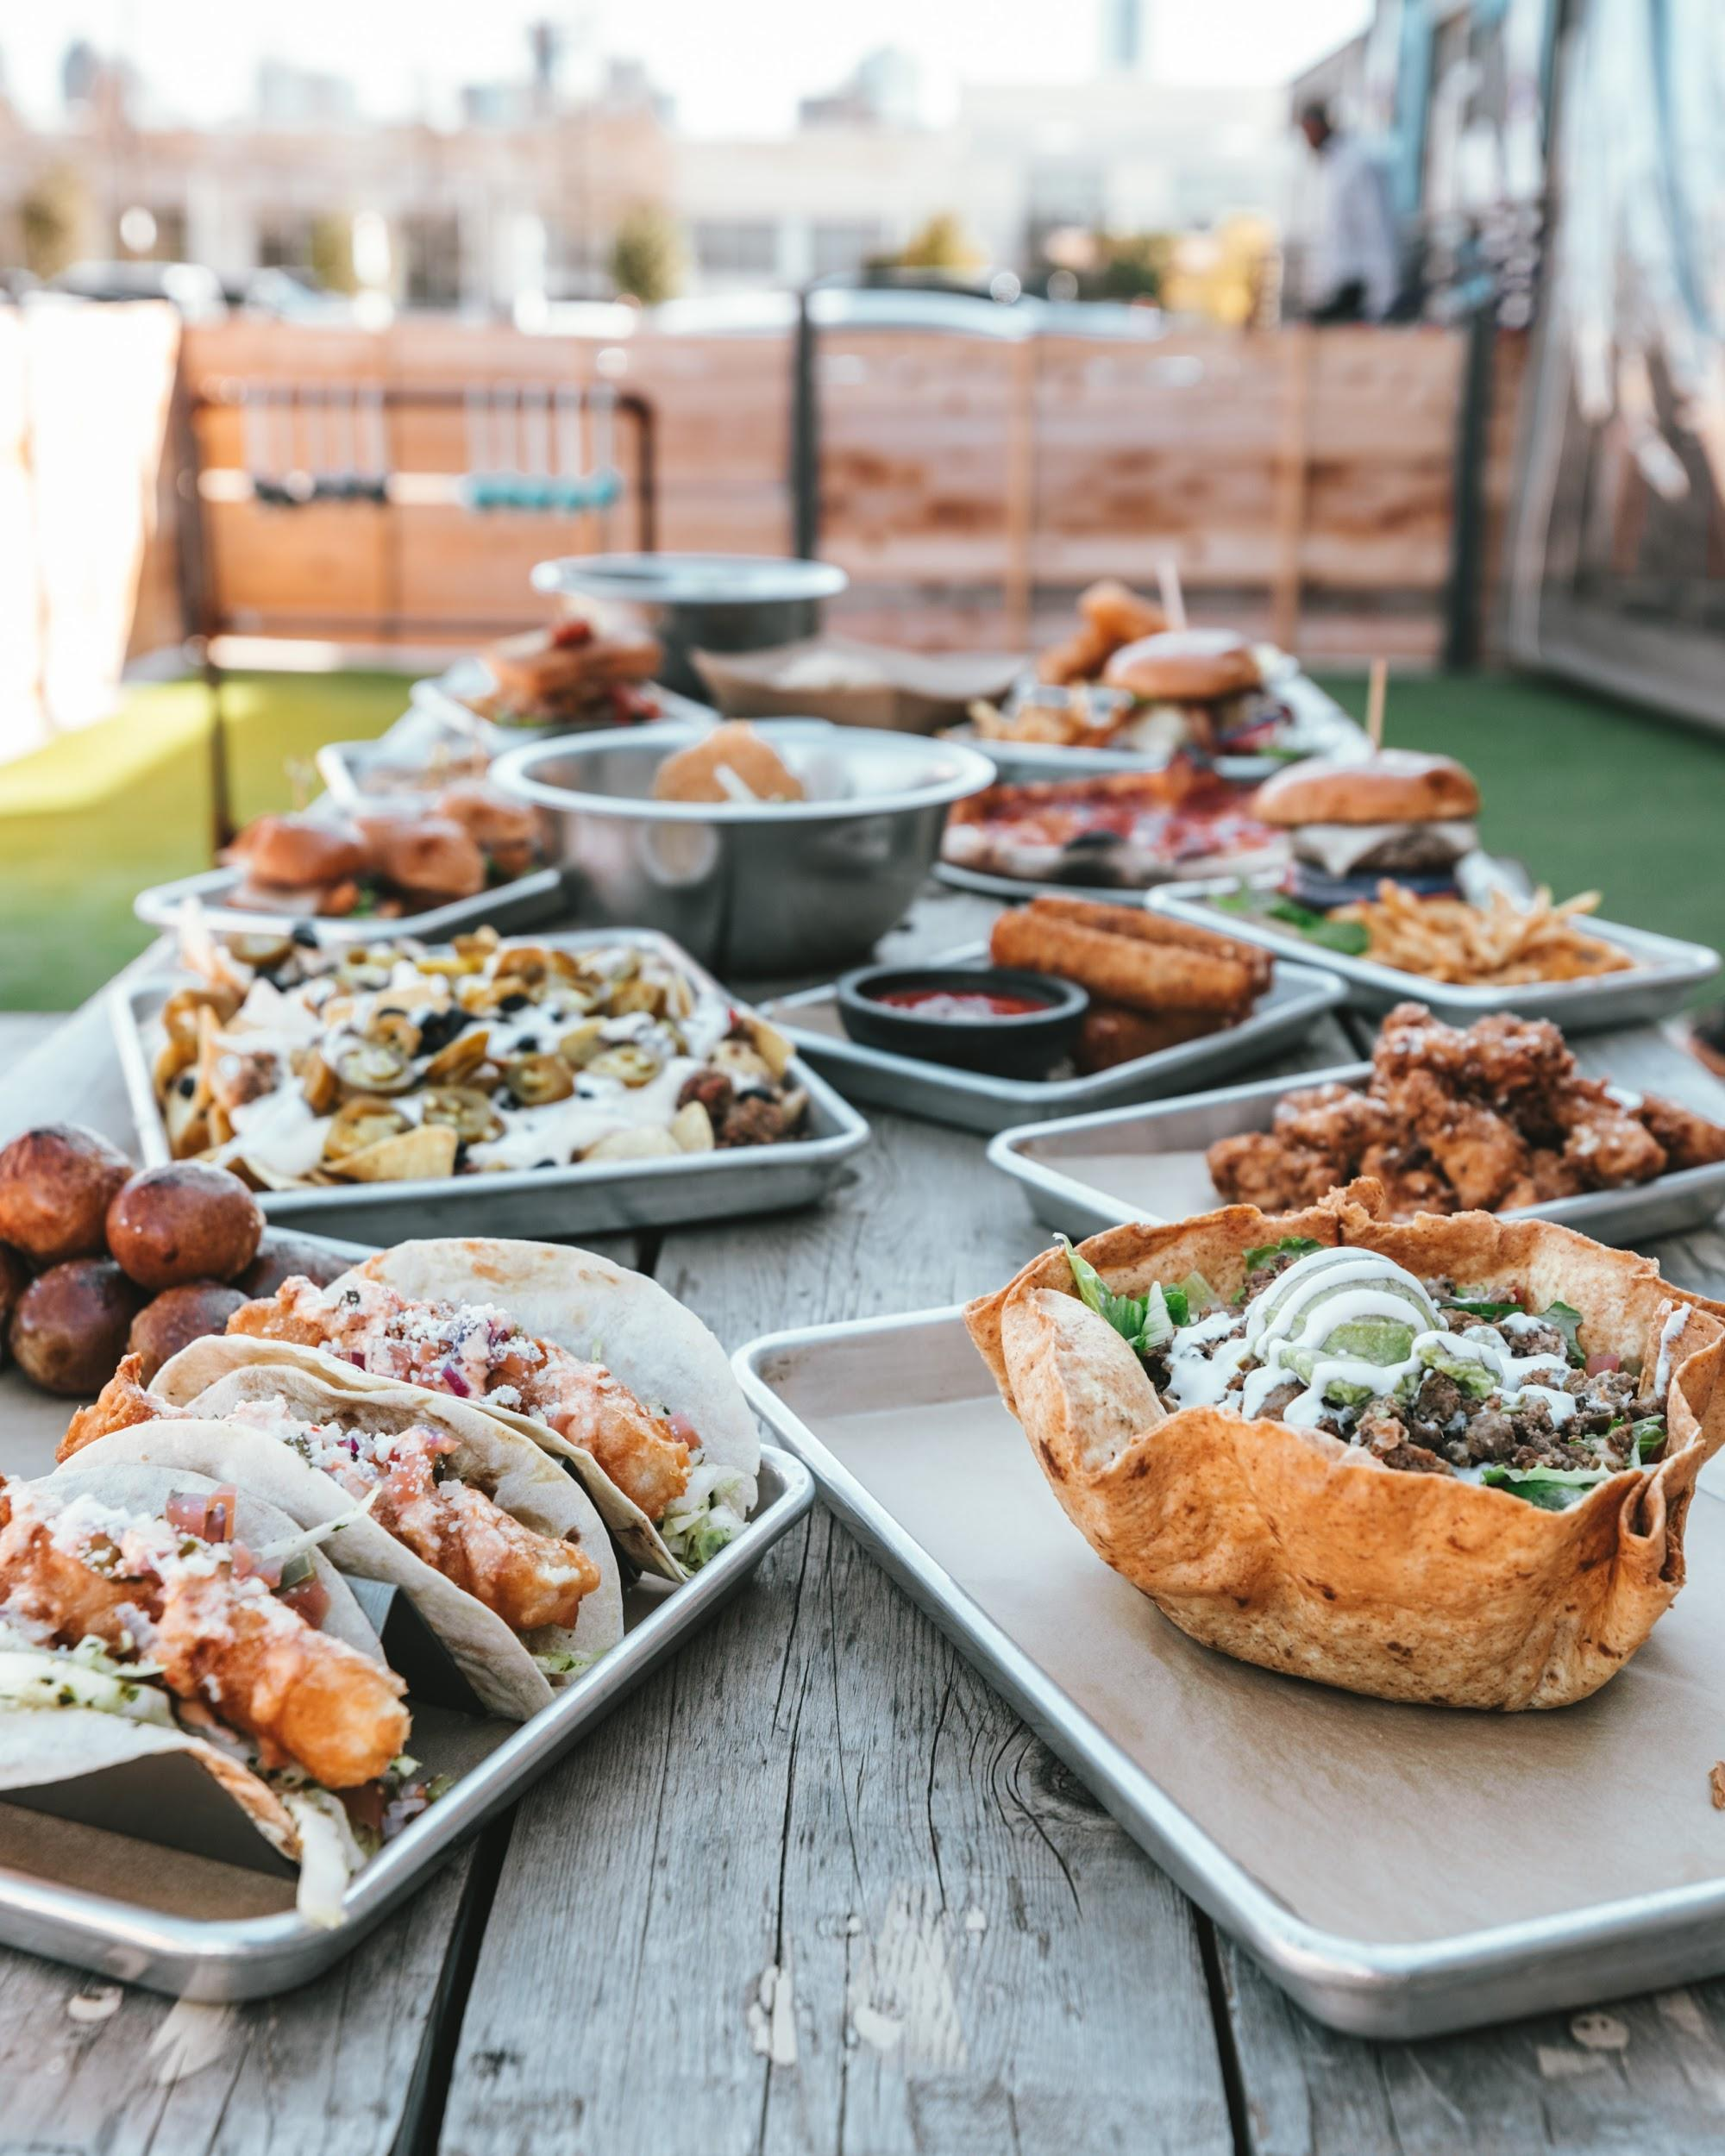
Party Host
If you’re hosting a party, it's important to create a safe environment for your guests.
Here are some helpful host tips:
Hold onto car keys of those that are drinking so they don’t get behind the wheel.
Have food high in protein to help slow alcohol absorption for those that are drinking.
Have some non-alcoholic drinks or mocktails for designated drivers.
Remind guests that they can face serious consequences if underage youth consume alcohol.
Encourage guests to consume no more than one standard drink per hour.

Slide 14
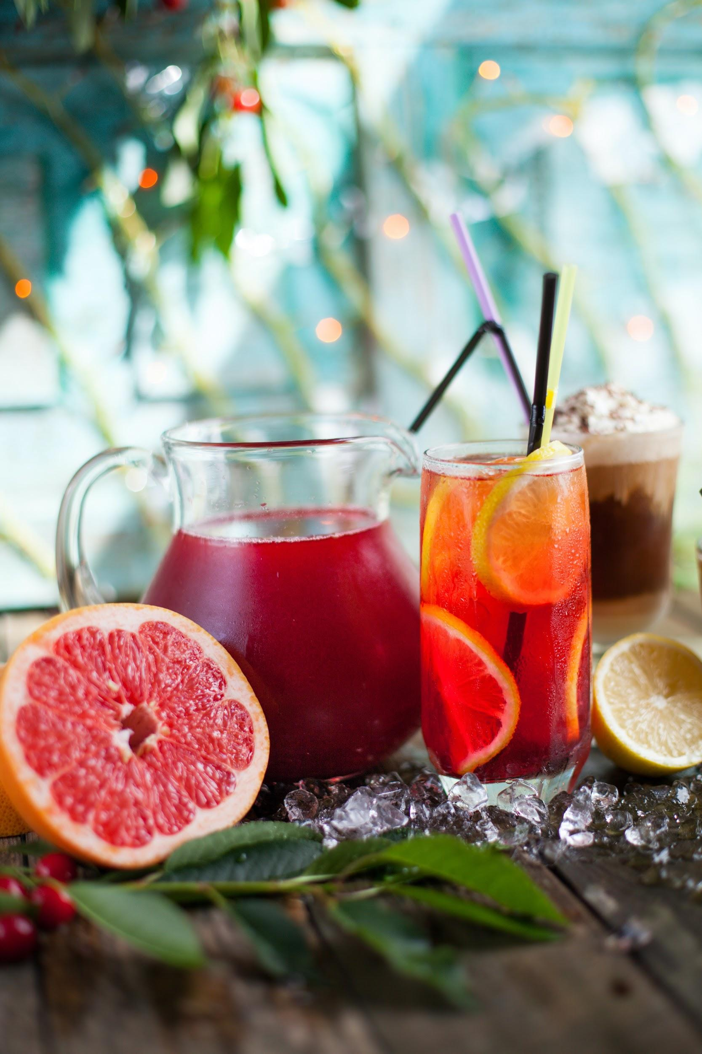
Non-Alcoholic Drinks
Non-alcoholic drinks can be more than just water. Consider having a fun, assorted selection such as:
Sparkling water
Lemonade
Iced tea
Fruit punch
Soda
Juice
Smoothies

Slide 15
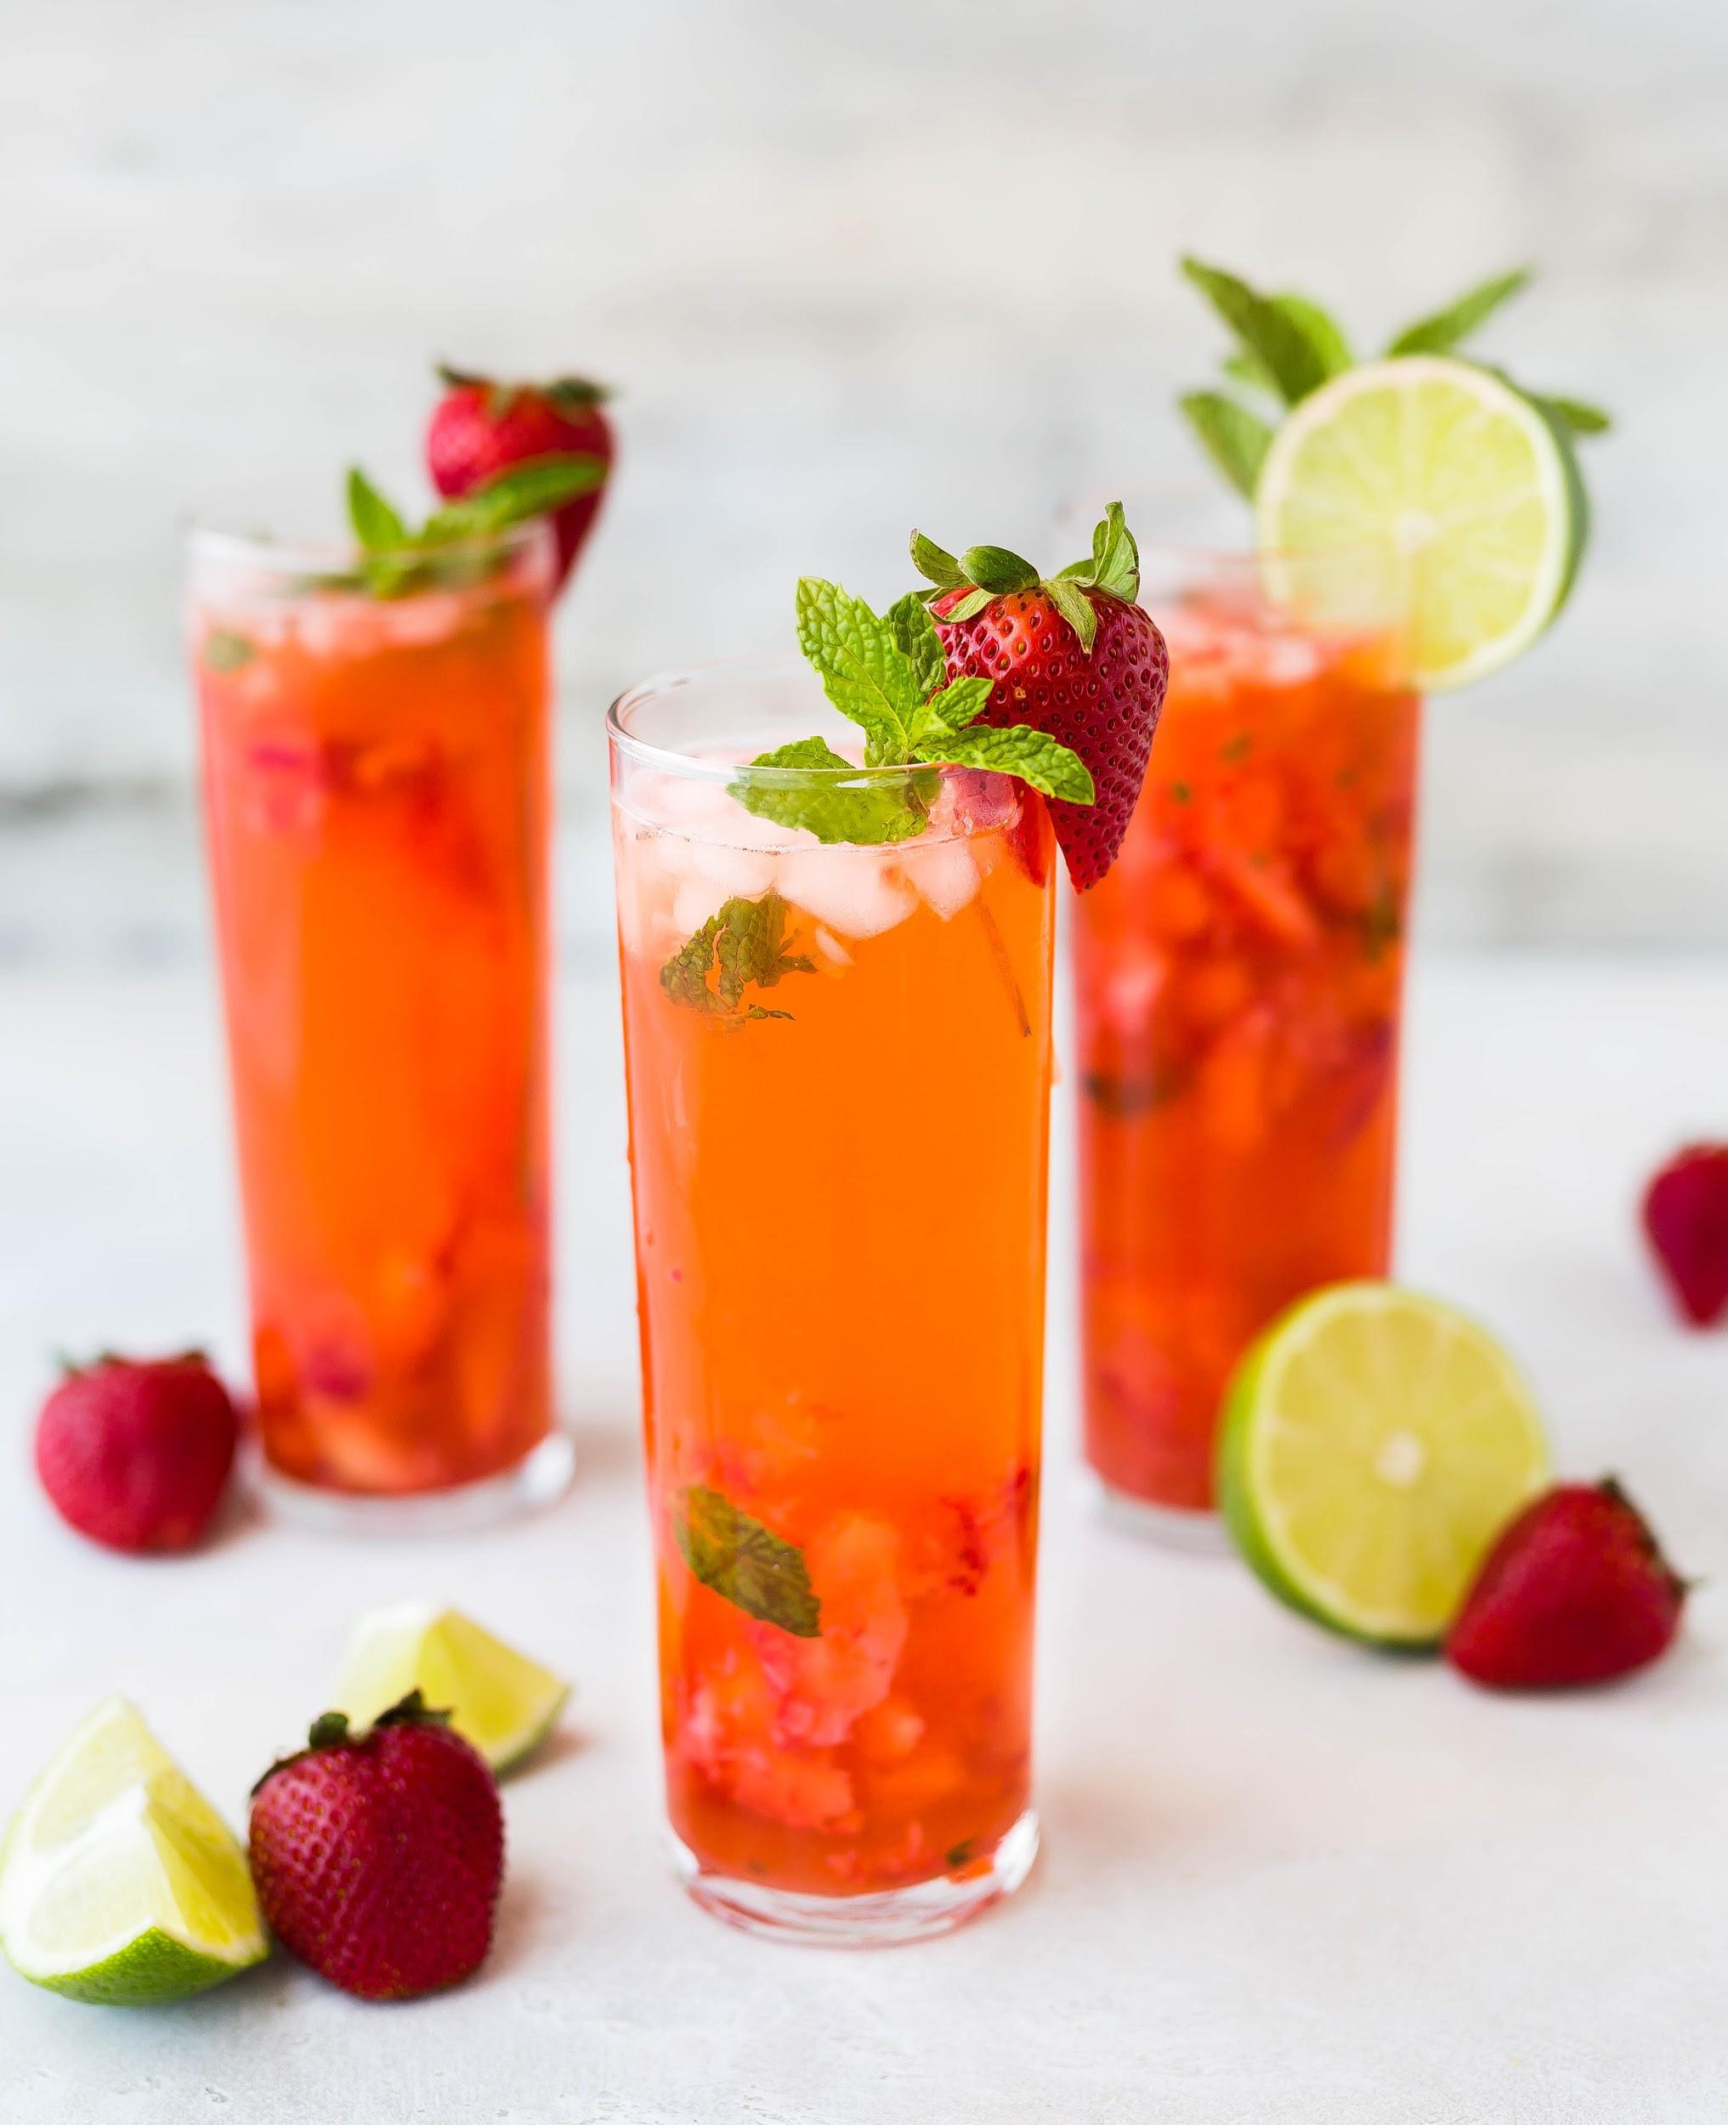
Mocktails
Mocktails are non-alcoholic, mixed drinks typically made out of fruit juice and soft drinks. This is another safe and fun drink option for designated drivers.
Strawberry Limenade (makes 2 cups):
¼ cup of homemade strawberry syrup
Juice from ½ lime
2 cups sparkling mineral water (chilled)
2 whole strawberries for decoration
Pour strawberry syrup and lime juice into glass
Fill glass with your choice of sparkling mineral water
Split strawberry and place on rim for decoration
Recipe courtesy from http://www.fussfreecooking.com/recipe-categories/sugary-treats/strawberry-limenade/

Slide 16
Hosting a Party
When the party starts winding down, have a rideshare ready for your guests that were drinking, offer to take them home (only if you are sober), or allow them to crash on your couch for the night.

Slide 17
100% of drunk driving collisions are preventable. Slow down. Have a sober driver. Keep your car serviced. And crash on a couch or get a room if you’ve been drinking.
Notes:
Taken from RADD’s homepage under RADD’s Mission

Slide 18
“Friends don’t let friends drive drunk… Do you?” ®

Slide 19
Check In Questions
Please click on the following link to test your knowledge on this lesson,
D.U.I. Prevention Strategies.
CLICK TO TAKE ONLINE QUIZ

Slide 20
For More Information
Please contact:
(SoCal) Marian Novak: marian@radd.org
(NorCal) Lindsey Peters: lindsey.peters@radd.org
Or visit www.RADD.org

