Slide 2
What is RADD®?
Founded in 1986 as Rockers Against Drunk Driving, RADD® promotes the use of designated drivers, ride shares and substance-free driving, making responsible behavior the norm. RADD's messages are non-judgmental and positive.
Mission Statement:
RADD® - The Entertainment Industry’s Voice for Road Safety, is dedicated to saving lives and reducing injuries through edutainment.

Slide 3
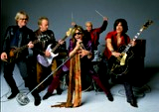
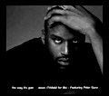
Why You Know RADD® Nationally
A decade of partnership with USDOT and NAB on the “Friends Don’t Let Friends Drive Drunk” Campaign:
America’s iconic Designated Driver campaign, produced by RADD® with over 100 personalities
RADD® honored with its first of two NHTSA “Lifesaver Awards”
Generated over $80 MM in earned media
Building strong community legs ever since!

Slide 4
Why You Know RADD Nationally: SMASHED
RADD® Youth Coalition / 1st National Teen Campaign to
Address Underage Drinking & Driving Prevention!
Accomplishments to Date:
Two prestigious national awards
NHTSA “Public Service Award” in 2005
GHSA “Peter J. O’Rourke Special
Achievement Award” in 2006
Heavy national and local media coverage for UDP
Military screenings - aircraft carrier “Harry S. Truman,” the Pentagon, NRSW, DC, etc.
BACCHUS Network created/executed successful SMASHED college campus mentoring model
National Safe & Drug Free Schools & OJJDP distribution to grantees
SADD & FCCLA chapters promoted screenings
30,000 copies distributed to date…all FREE! And all were requested!
NHTSA printed another 5,000 copies in fall 2012
A tool for use in your own
comprehensive programming

Slide 5
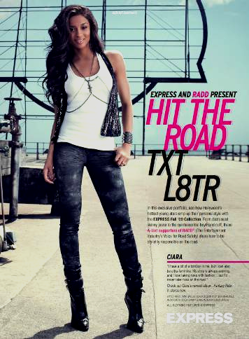
RADD® Nationally: Anti-Texting
First national anti-texting campaign in the US!
Accomplishments:
RADD®, Express stores and Elle Magazine
5.8MM readers saw 3.5 pages in August ‘09 ELLE
590 Express retail stores: free RADD® T-shirt
with coupon after viewing PSA online
64MM customer blast emails by Express, social
networking blogs by the young stars, and PR
WHO Global Media Contest Honorable Mention 2010
Total Impressions: 44,100,000

Slide 6
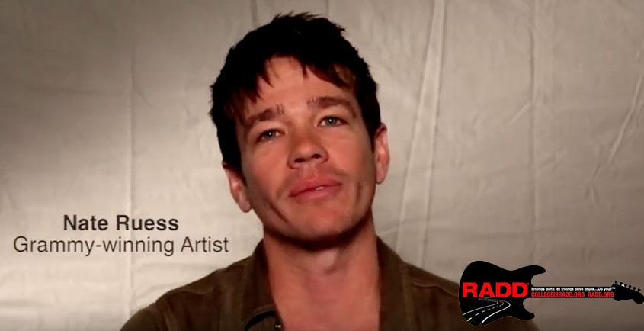
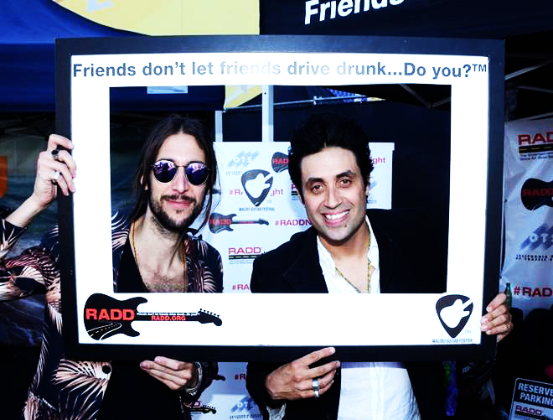
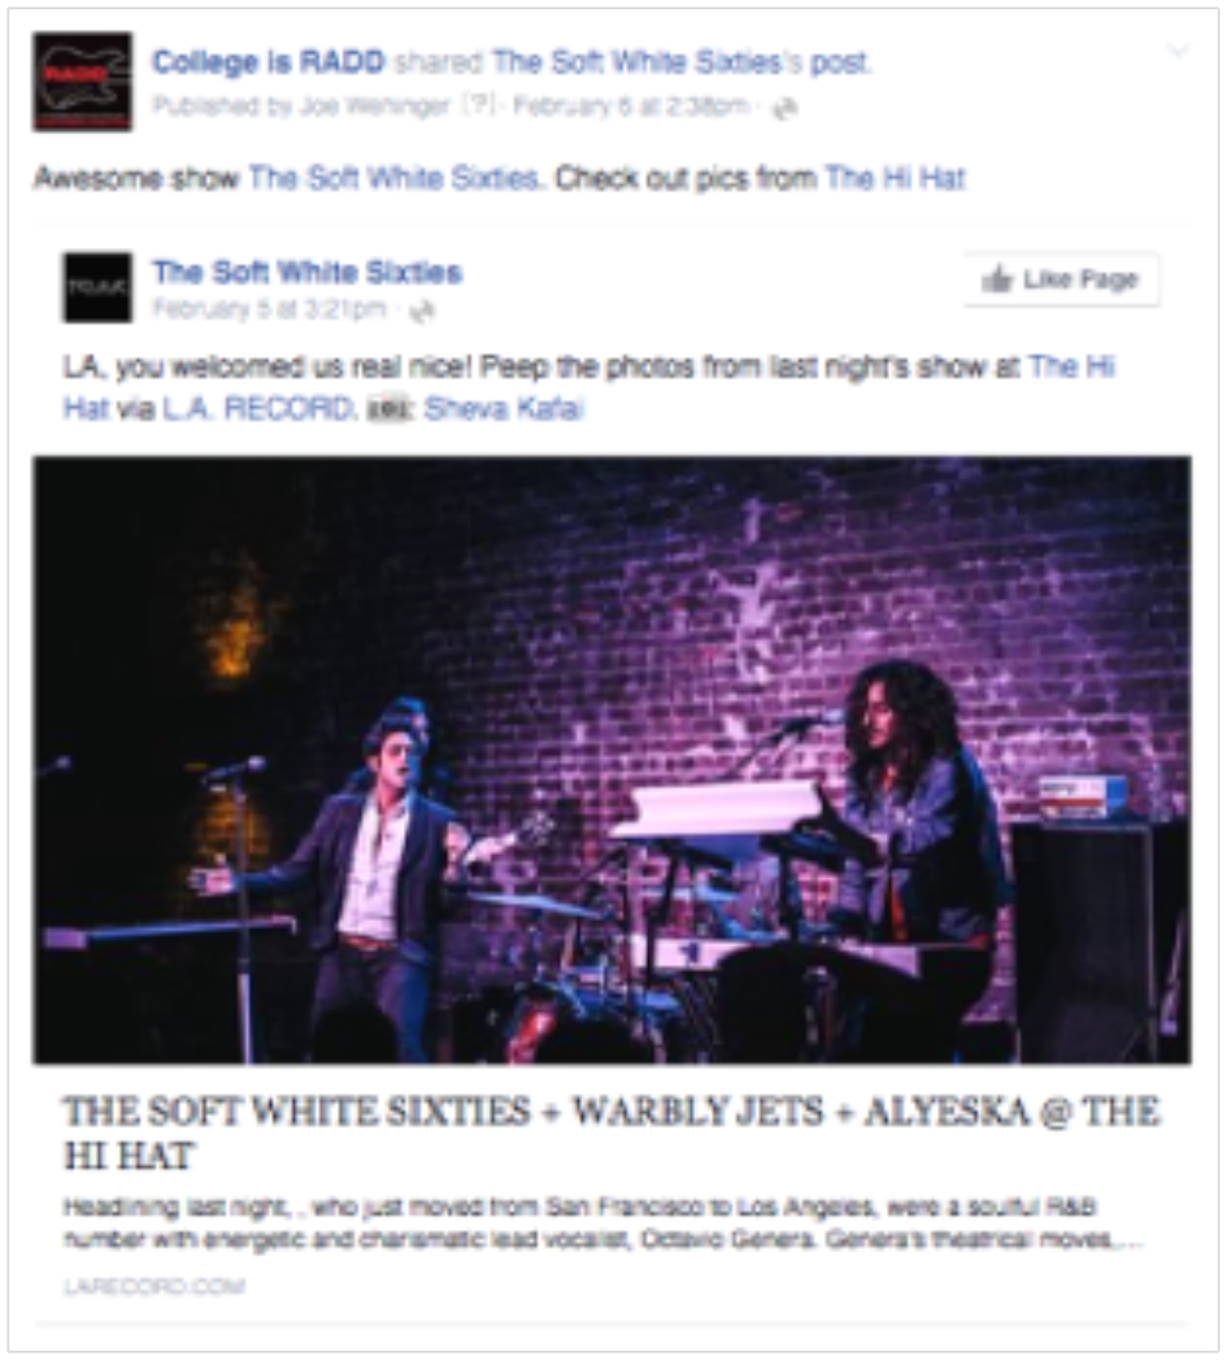
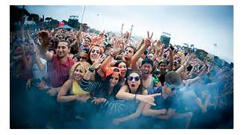
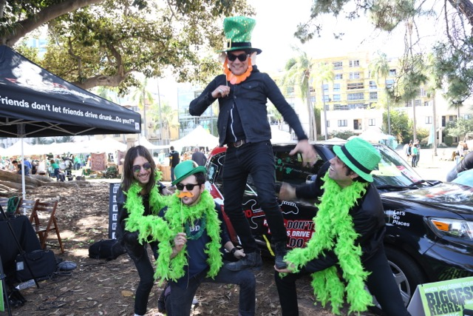
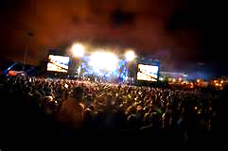
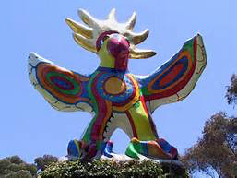
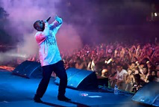
RADD National & CA: Music Engagement

Slide 7
RADD® California Coalition
In 2005, the RADD® CALIFORNIA COALITION (RCC) was formed to engage business, media, hospitality and government leaders in a statewide effort to utilize business and marketing strategies to further reduce deaths and injuries among ages 18 to 34 on California’s roads.
Co-chaired by RADD ® and the California Department of Alcohol Beverage Control (ABC), the RCC serves as the State of California’s Hospitality Coalition.

Slide 8
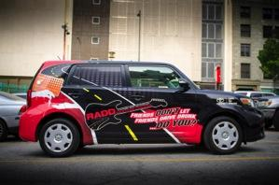
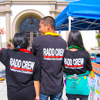
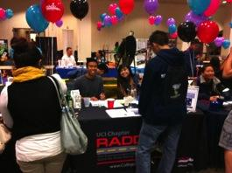
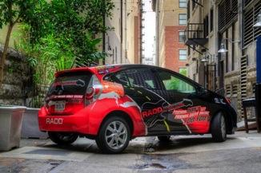
College is RADD®
The project promotes alcohol-free driving to college-age young adults throughout California via RADD’s educational tools for use on college campuses, military bases, and social media.
This statewide project has worked with over 60 college campuses, stretching throughout California.

Slide 9
A Positive Message: “Have Fun. Be Safe.”
The RADD® message, Plan Ahead! Friends Don’t Let Friends Drive Drunk…Do You? ® encourages students to be or use a DD, use rideshare, call a taxi, or take public transportation when going out to socialize.
The “…Do You?” tag is a call to action to challenge students to take personal responsibility for themselves
and their friends.

Slide 10
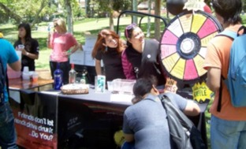
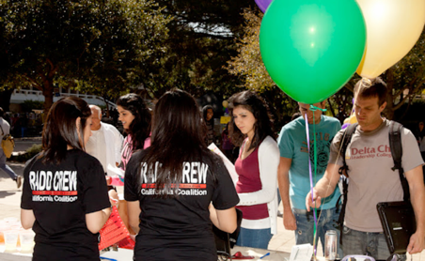
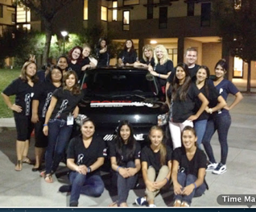
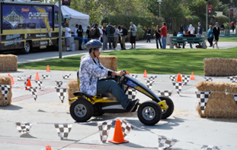
RADD® On-Campus Support
RADD® works with college staff and student peer educators to provide training for each campus, staffing assistance for major campus events, and collateral materials for campus distribution.

Slide 11
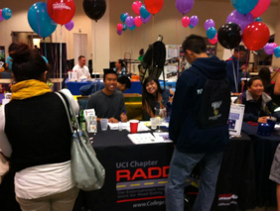
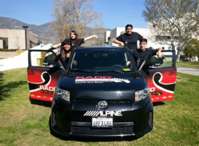
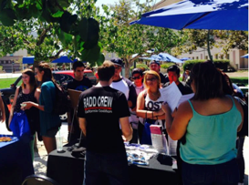
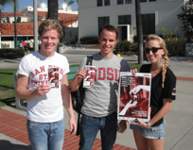
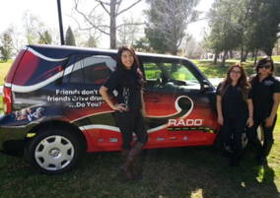
RADD® Energizes Campus Events
Have Fun.
Be Safe.

Slide 12
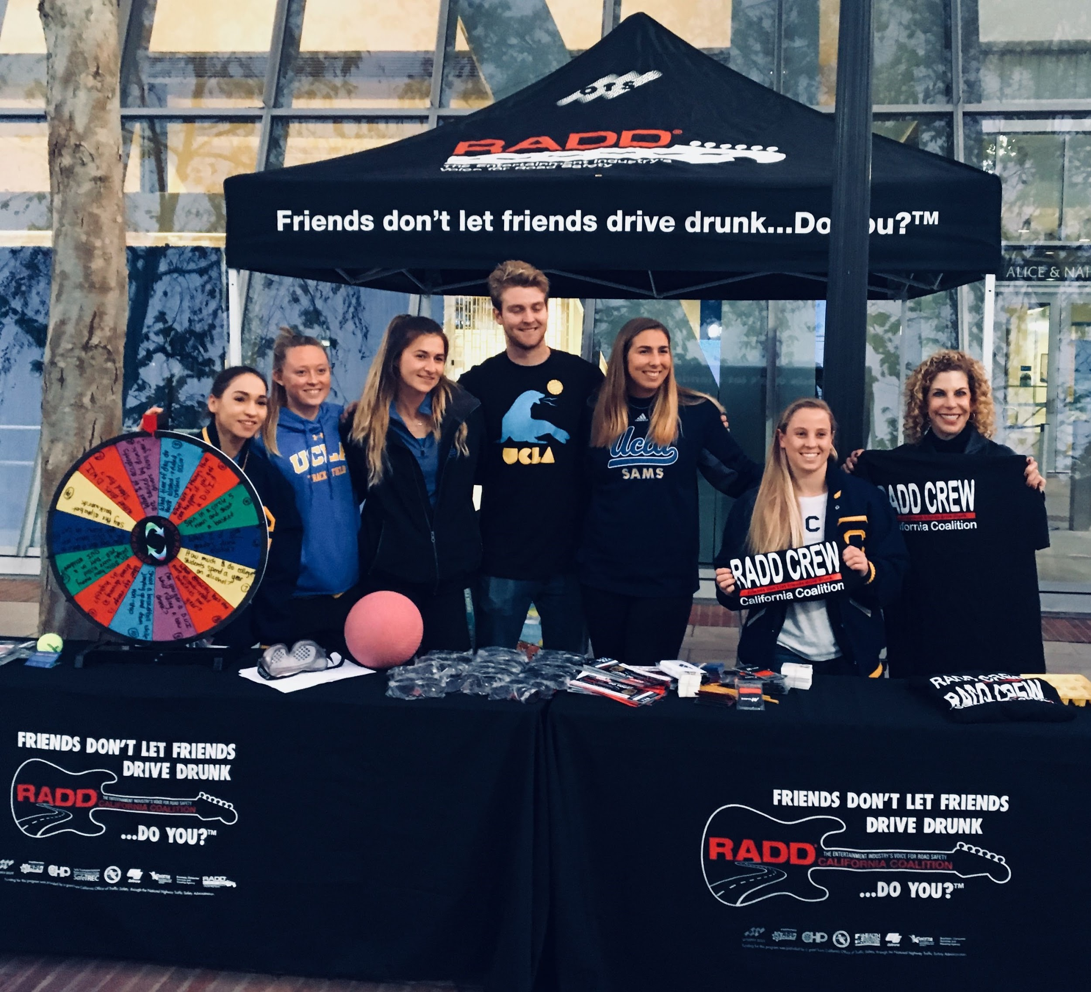
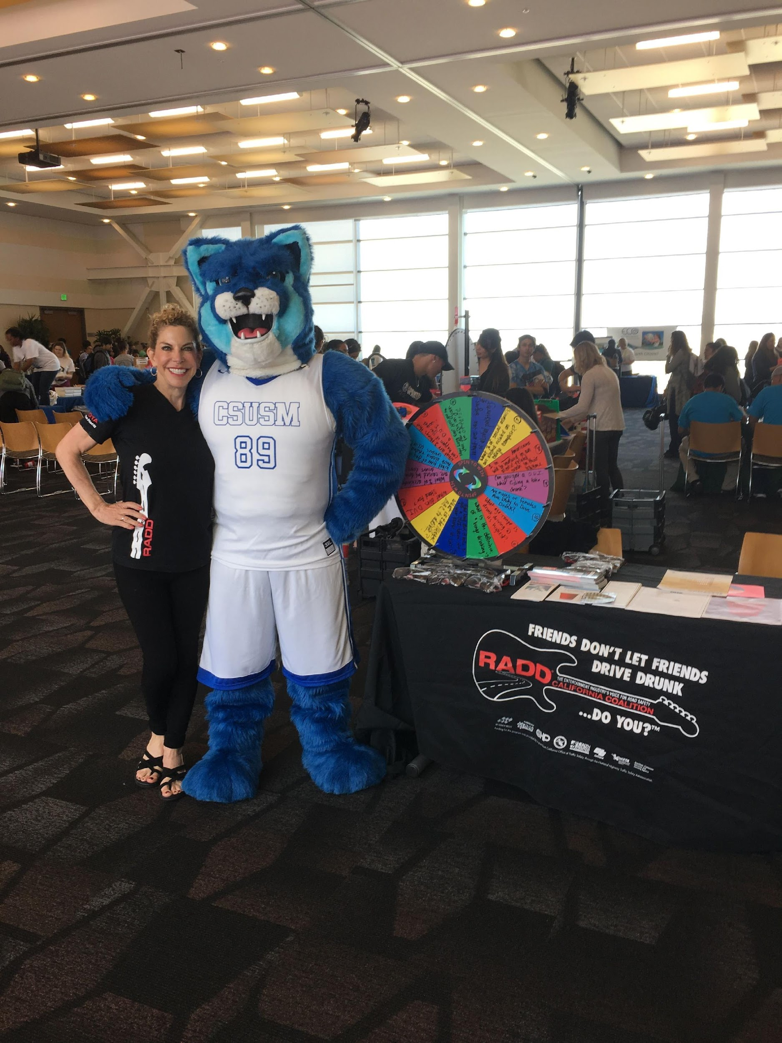
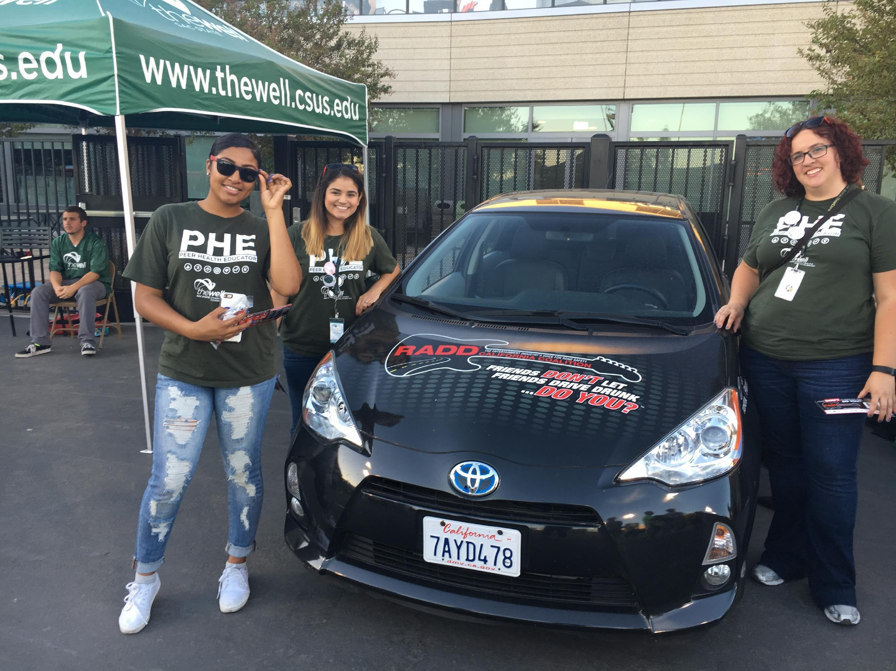
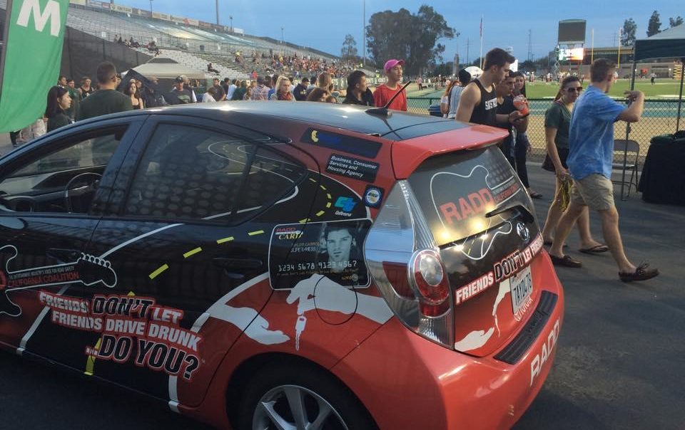
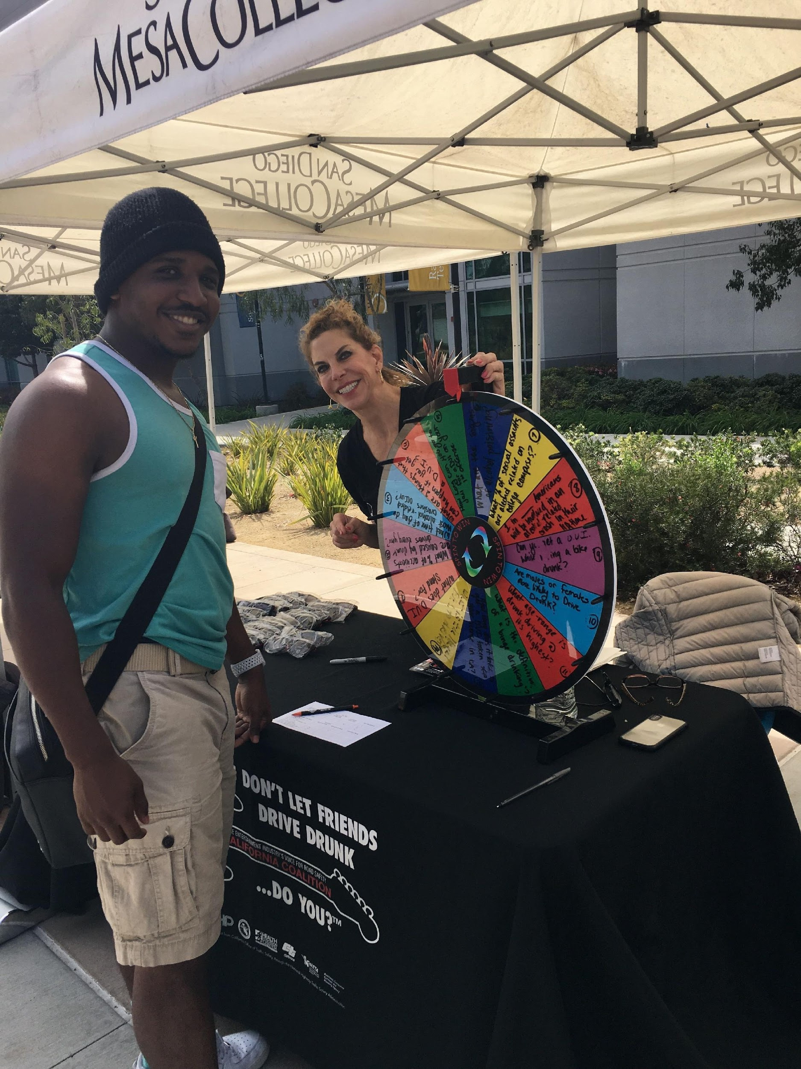
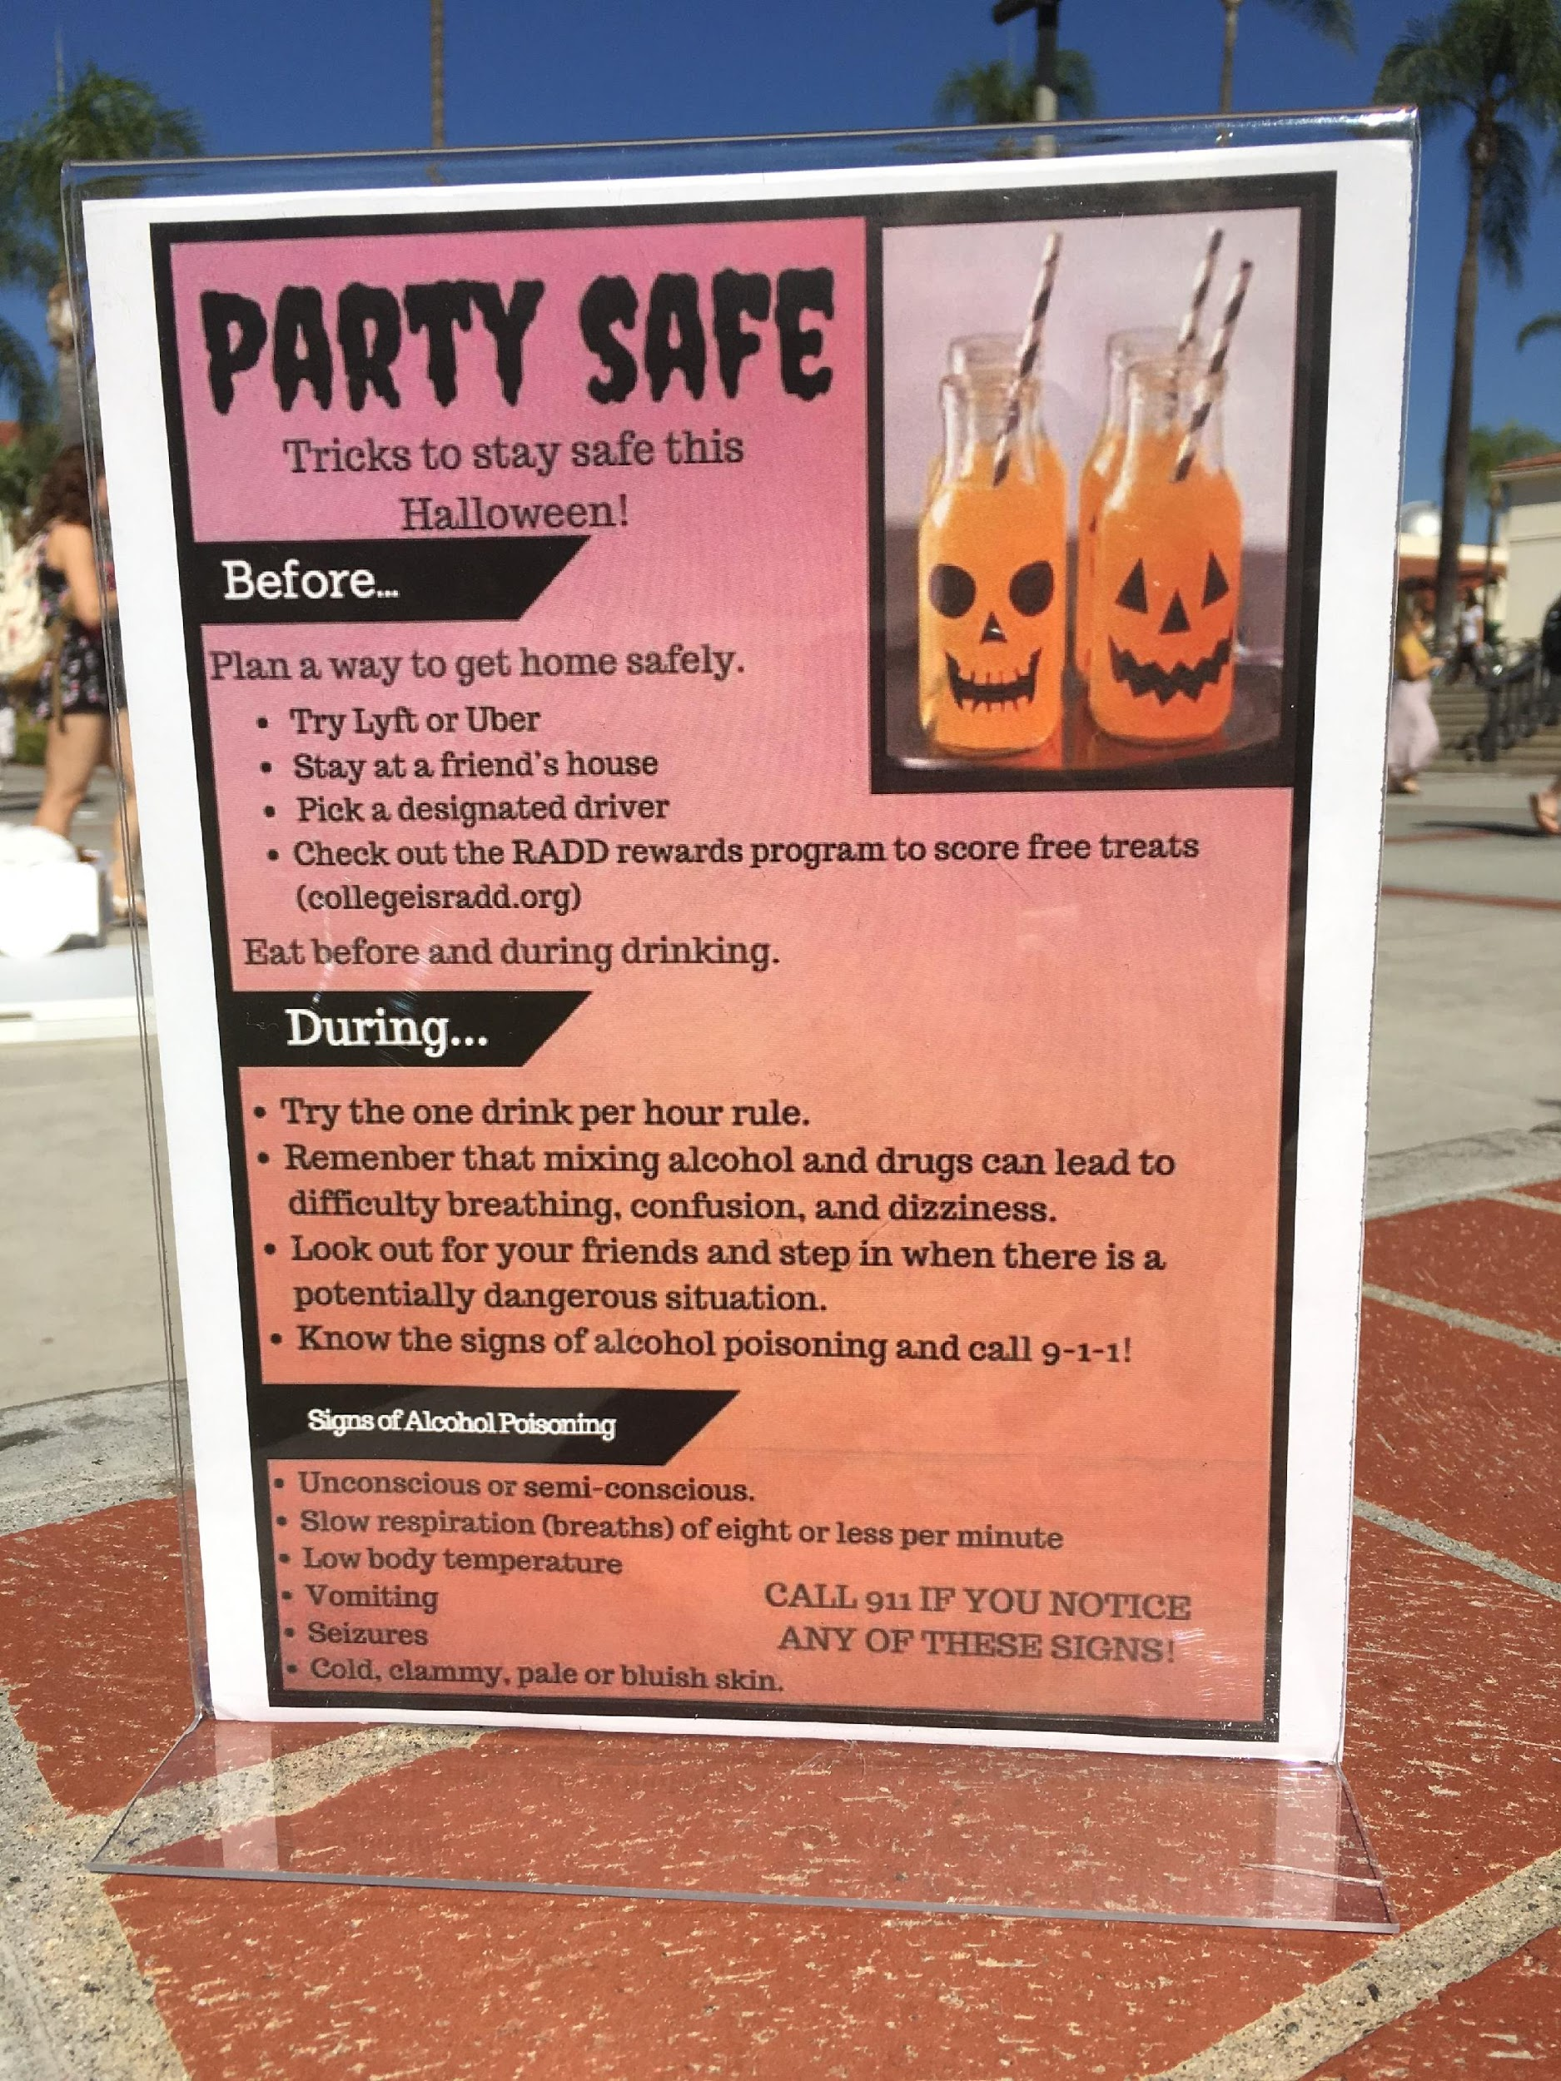
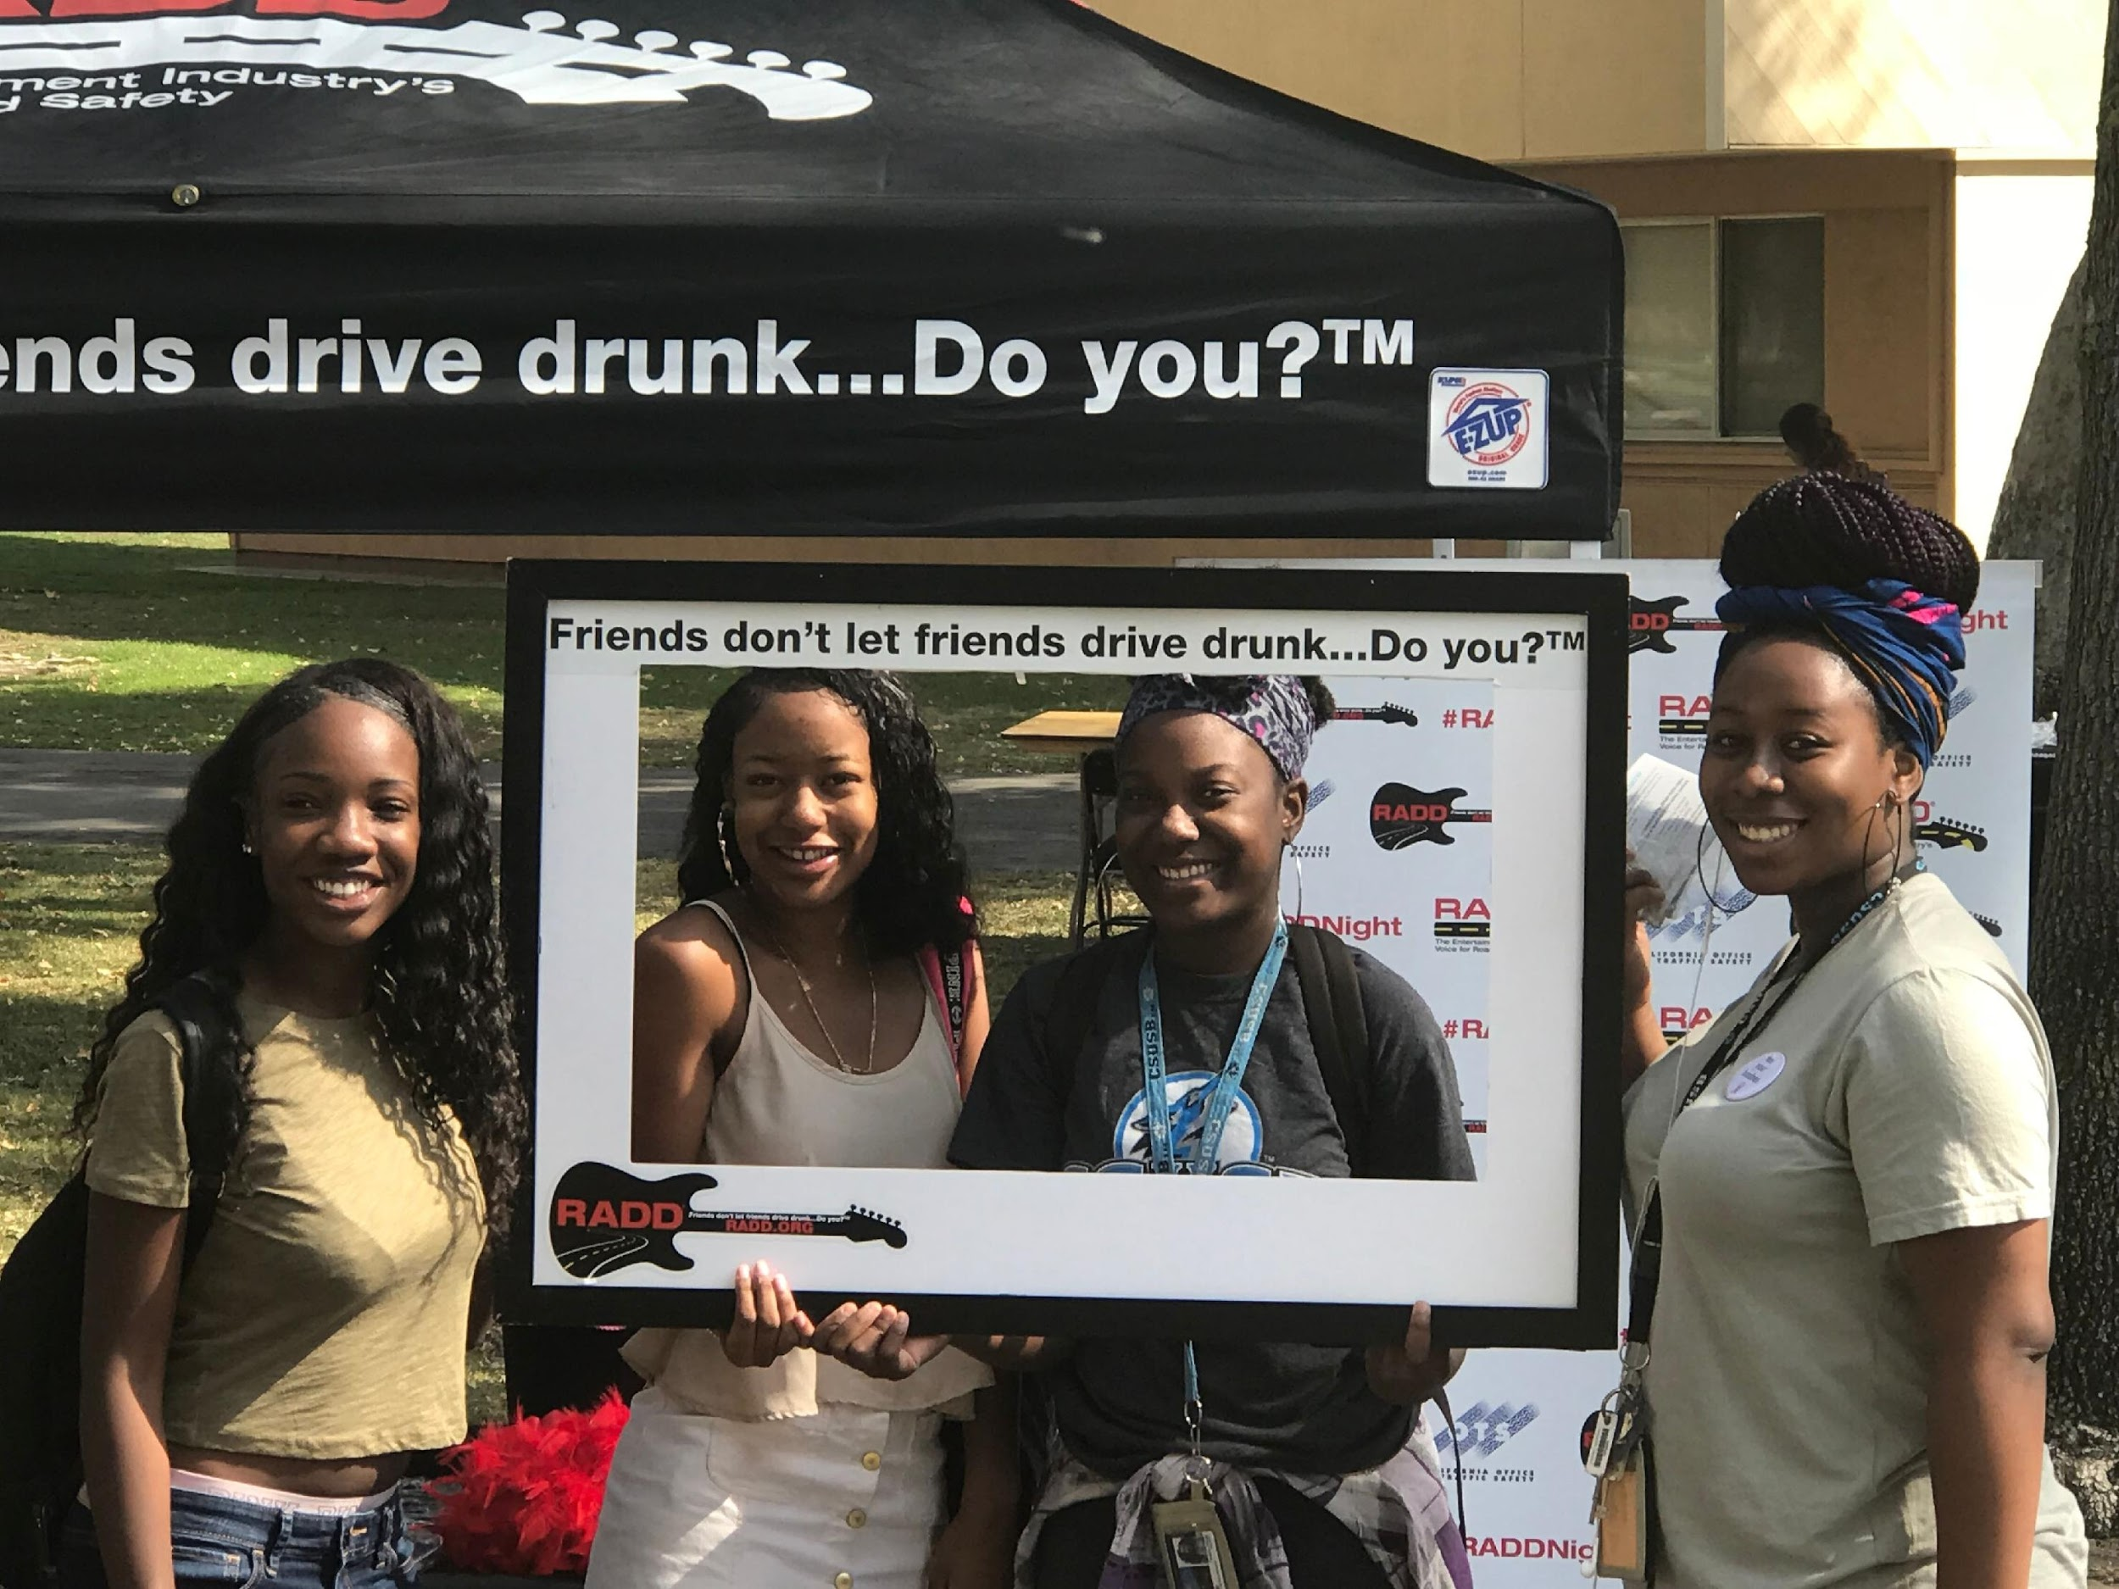
RADD® Energizes Campus Events

Slide 13
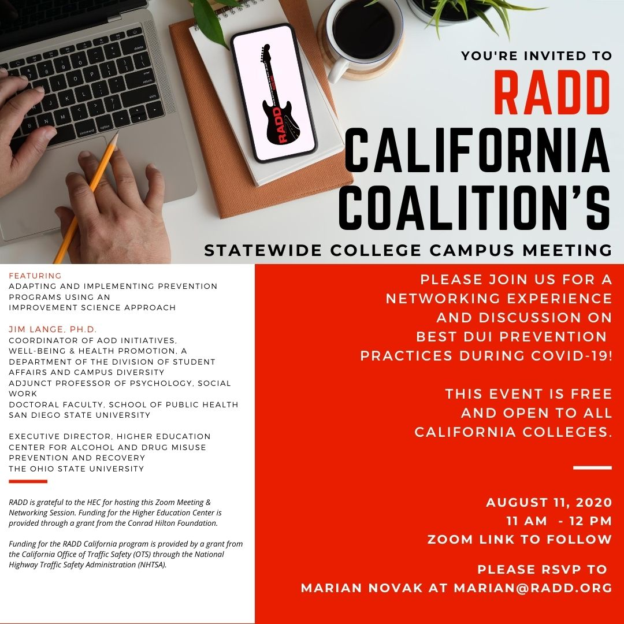
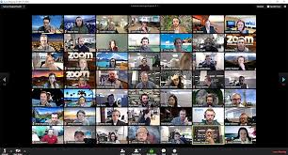
New!
Virtual Event Options
New!
-Virtual Health Fairs
-Zoom Presentations and Trainings for:
-Peer Health Educators
-Fraternities and Sororities
-Resident Advisors
-Athletes
-Holiday Messaging via Social Media
-Support for Major Programming Windows such as:
-National Collegiate Alcohol Awareness Month
-Back to School
-Spring Break
-Graduation

Slide 14
New!
RADD® Resource Center
New!
Your campus go-to for printable materials, alcohol-related lessons, and social media templates.
https://radd-resources.org

Slide 15
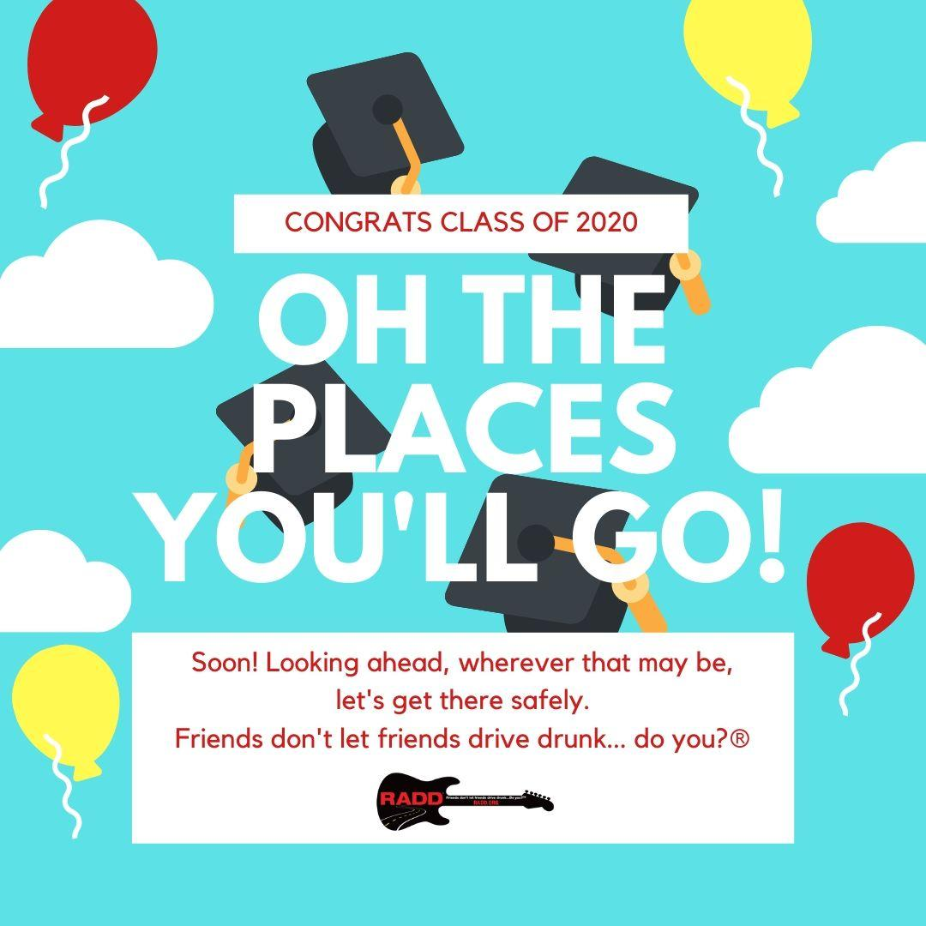
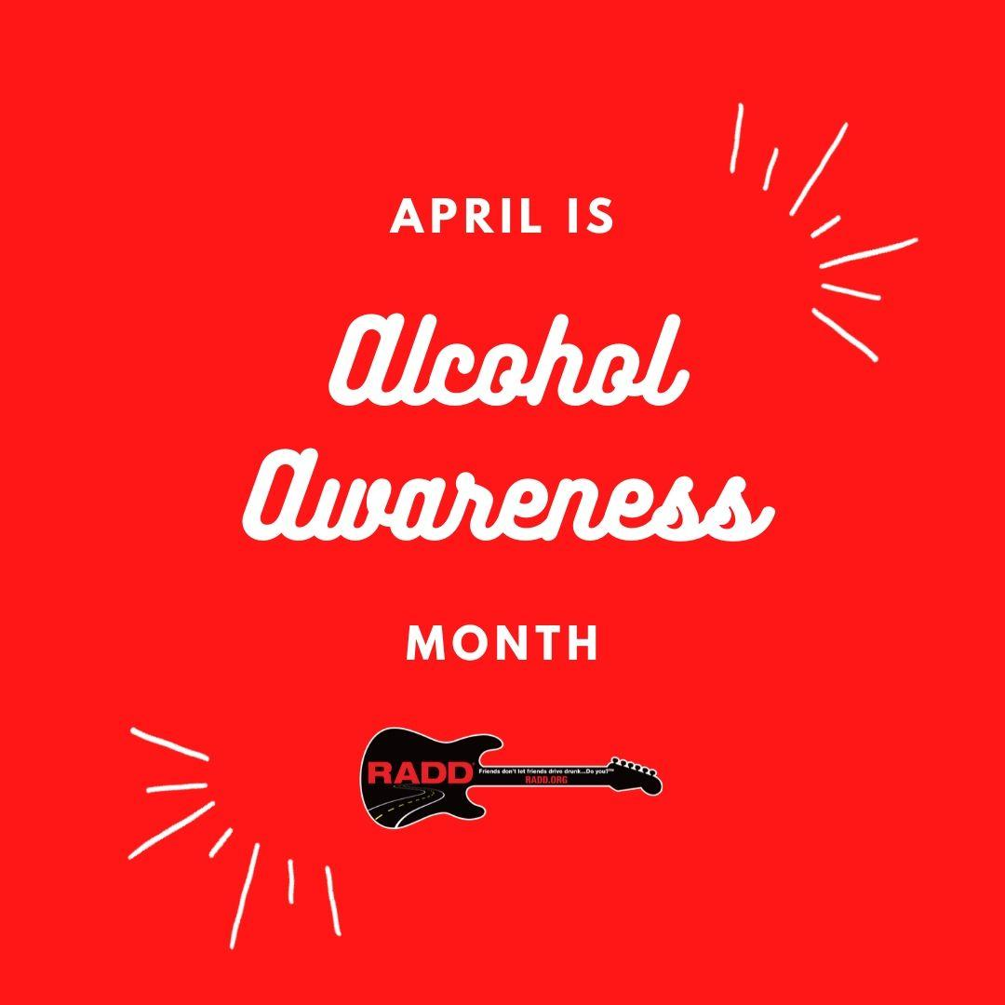
New!
Social Media
New!
RADD® Messaging via Social Media Supports Major Programming Windows such as:
-National Collegiate Alcohol Awareness Month
-Back to School -Graduation
-Spring Break -Holiday

Slide 16
New!
Downloadable Postcards
New!

Slide 17
New!
Downloadable 8.5x11 Flyers
New!

Slide 18
Stay Connected with RADD®
For more information please contact:
Lindsey Peters – Northern California Manager
lindsey.peters@radd.org

