Slide 1
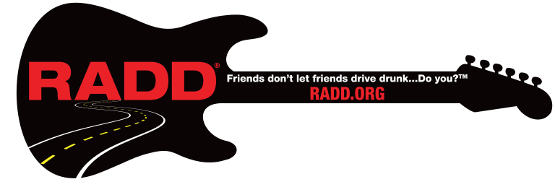
We are the Entertainment Industry’s Voice for Road Safety.
Recording Artists Against Drunk Driving®
Lesson 1: Alcohol Consumption

Slide 2
Founded in 1986 as Rockers Against Drunk Driving, RADD® advocates the use of designated drivers, rideshares, seatbelts and safe driving through full control behind the wheel, making responsible behavior the norm. RADD's messages are non-judgmental and positive.
Now Recording Artists Against Drunk Driving, RADD® acts as
The Entertainment Industry’s Voice for Road Safety and is dedicated to saving lives and reducing injuries through edutainment.

Slide 3
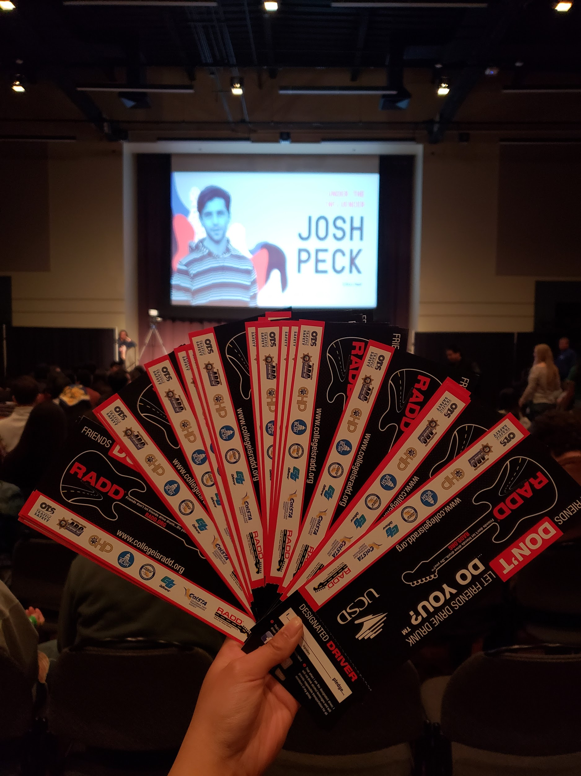
RADD® is a 501 c3 nonprofit, funded in California by the California Office of Traffic Safety (OTS). We implement education and DUI prevention strategies by traveling over 50,000 miles a year to 40+ college campuses throughout California!
RADD at UCSD’s Triton Fest event, “Under the Influencer with Josh Peck”.

Slide 4
Overview and Learning Objectives
In this lesson, we will go over alcohol consumption, which will include:
Alcohol absorption
What’s in a drink
Underage drinking
Binge drinking
Drinking on campus
House parties - Social Host Ordinance
What is the purpose of this lesson?
The purpose of this lesson is to teach young adults how to understand alcohol absorption, how to recognize standard drink sizes and why it is important, and to provide education on the following alcohol consumption issues: underage drinking, binge drinking, drinking on campus, and drinking at house parties.

Slide 5
Alcohol Absorption

Slide 6
Alcohol and the Body
When consumed, alcohol makes its way to the stomach and small intestines where it becomes absorbed into the bloodstream and metabolized (broken down) by the liver.
Because alcohol does not have a use for the body, alcohol does not get stored. Alcohol will then remain in body water until eliminated, which is the responsibility of the liver.
The rate in which alcohol gets absorbed into the bloodstream depends on several factors. For some people, alcohol gets absorbed faster than others, which causes them to feel the effects of alcohol sooner.
Some factors to consider include:
Being male or female
Body build
Drinking on an empty stomach
Spacing out your drinks
https://shop.ucsc.edu/alcohol-other-drugs/alcohol/your-body.html
Notes:
https://shop.ucsc.edu/alcohol-other-drugs/alcohol/your-body.html

Slide 7
Alcohol Absorption
Physiological factors play a role in alcohol absorption. Below is a comparison of males and females and how alcohol intake affects them differently.
Male
Less body fat and more body water, which will dilute the alcohol concentration in the body.
Has more enzymes to break down alcohol.
Female
More body fat and less body water, meaning a higher concentration of alcohol in the body.
Has less enzymes to break down alcohol.
Birth control pills that contain estrogen will slow down the alcohol elimination rate of the body.
https://shop.ucsc.edu/alcohol-other-drugs/alcohol/your-body.html
Notes:
https://shop.ucsc.edu/alcohol-other-drugs/alcohol/your-body.html

Slide 8
Alcohol Absorption
Other factors that play a role in alcohol absorption include how you drink, such as drinking on an empty stomach and spacing out your drinks for reasonable consumption.
Food Consumption
Drinking on an empty stomach allows for alcohol to be absorbed and metabolized quicker than having food in your system.
Having food in your system, such as protein and carbohydrates, slows down the absorption process as protein and carbohydrates will get metabolized first.
https://shop.ucsc.edu/alcohol-other-drugs/alcohol/your-body.html
Notes:
https://shop.ucsc.edu/alcohol-other-drugs/alcohol/your-body.html

Slide 9
Alcohol Absorption
Reasonable Consumption
By spacing out how many drinks you have per hour, you can control your blood alcohol content. Consuming many drinks per hour will overtax your liver’s ability to metabolize alcohol.
Lower risk drinking would be considered as having zero to one standard drink per day for women and up to two drinks per day for men.
https://shop.ucsc.edu/alcohol-other-drugs/alcohol/your-body.html
https://www.rethinkingdrinking.niaaa.nih.gov/how-much-is-too-much/is-your-drinking-pattern-risky/Drinking-Levels.aspx
Notes:
https://shop.ucsc.edu/alcohol-other-drugs/alcohol/your-body.html
https://www.rethinkingdrinking.niaaa.nih.gov/how-much-is-too-much/is-your-drinking-pattern-risky/Drinking-Levels.aspx

Slide 10
Question:
What age range has the highest number of DUI’s?

Slide 11
Answer:
21 - 26 year olds

Slide 12
What’s in a Drink

Slide 13
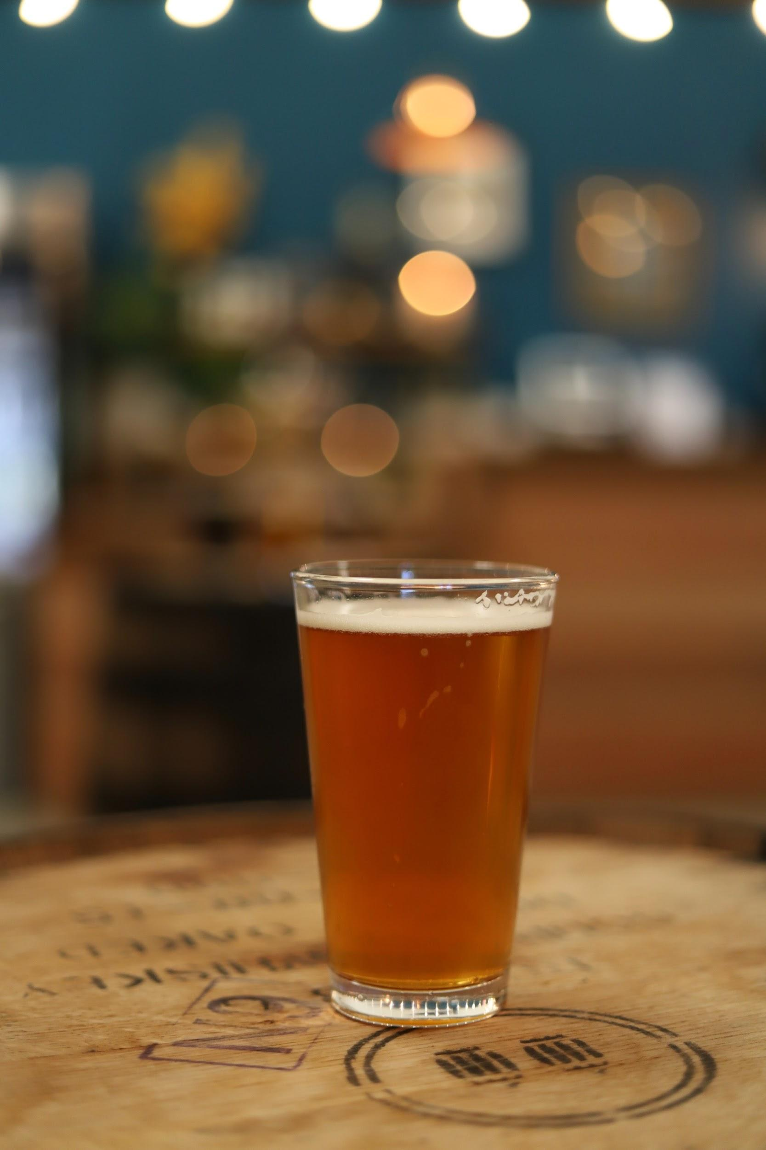
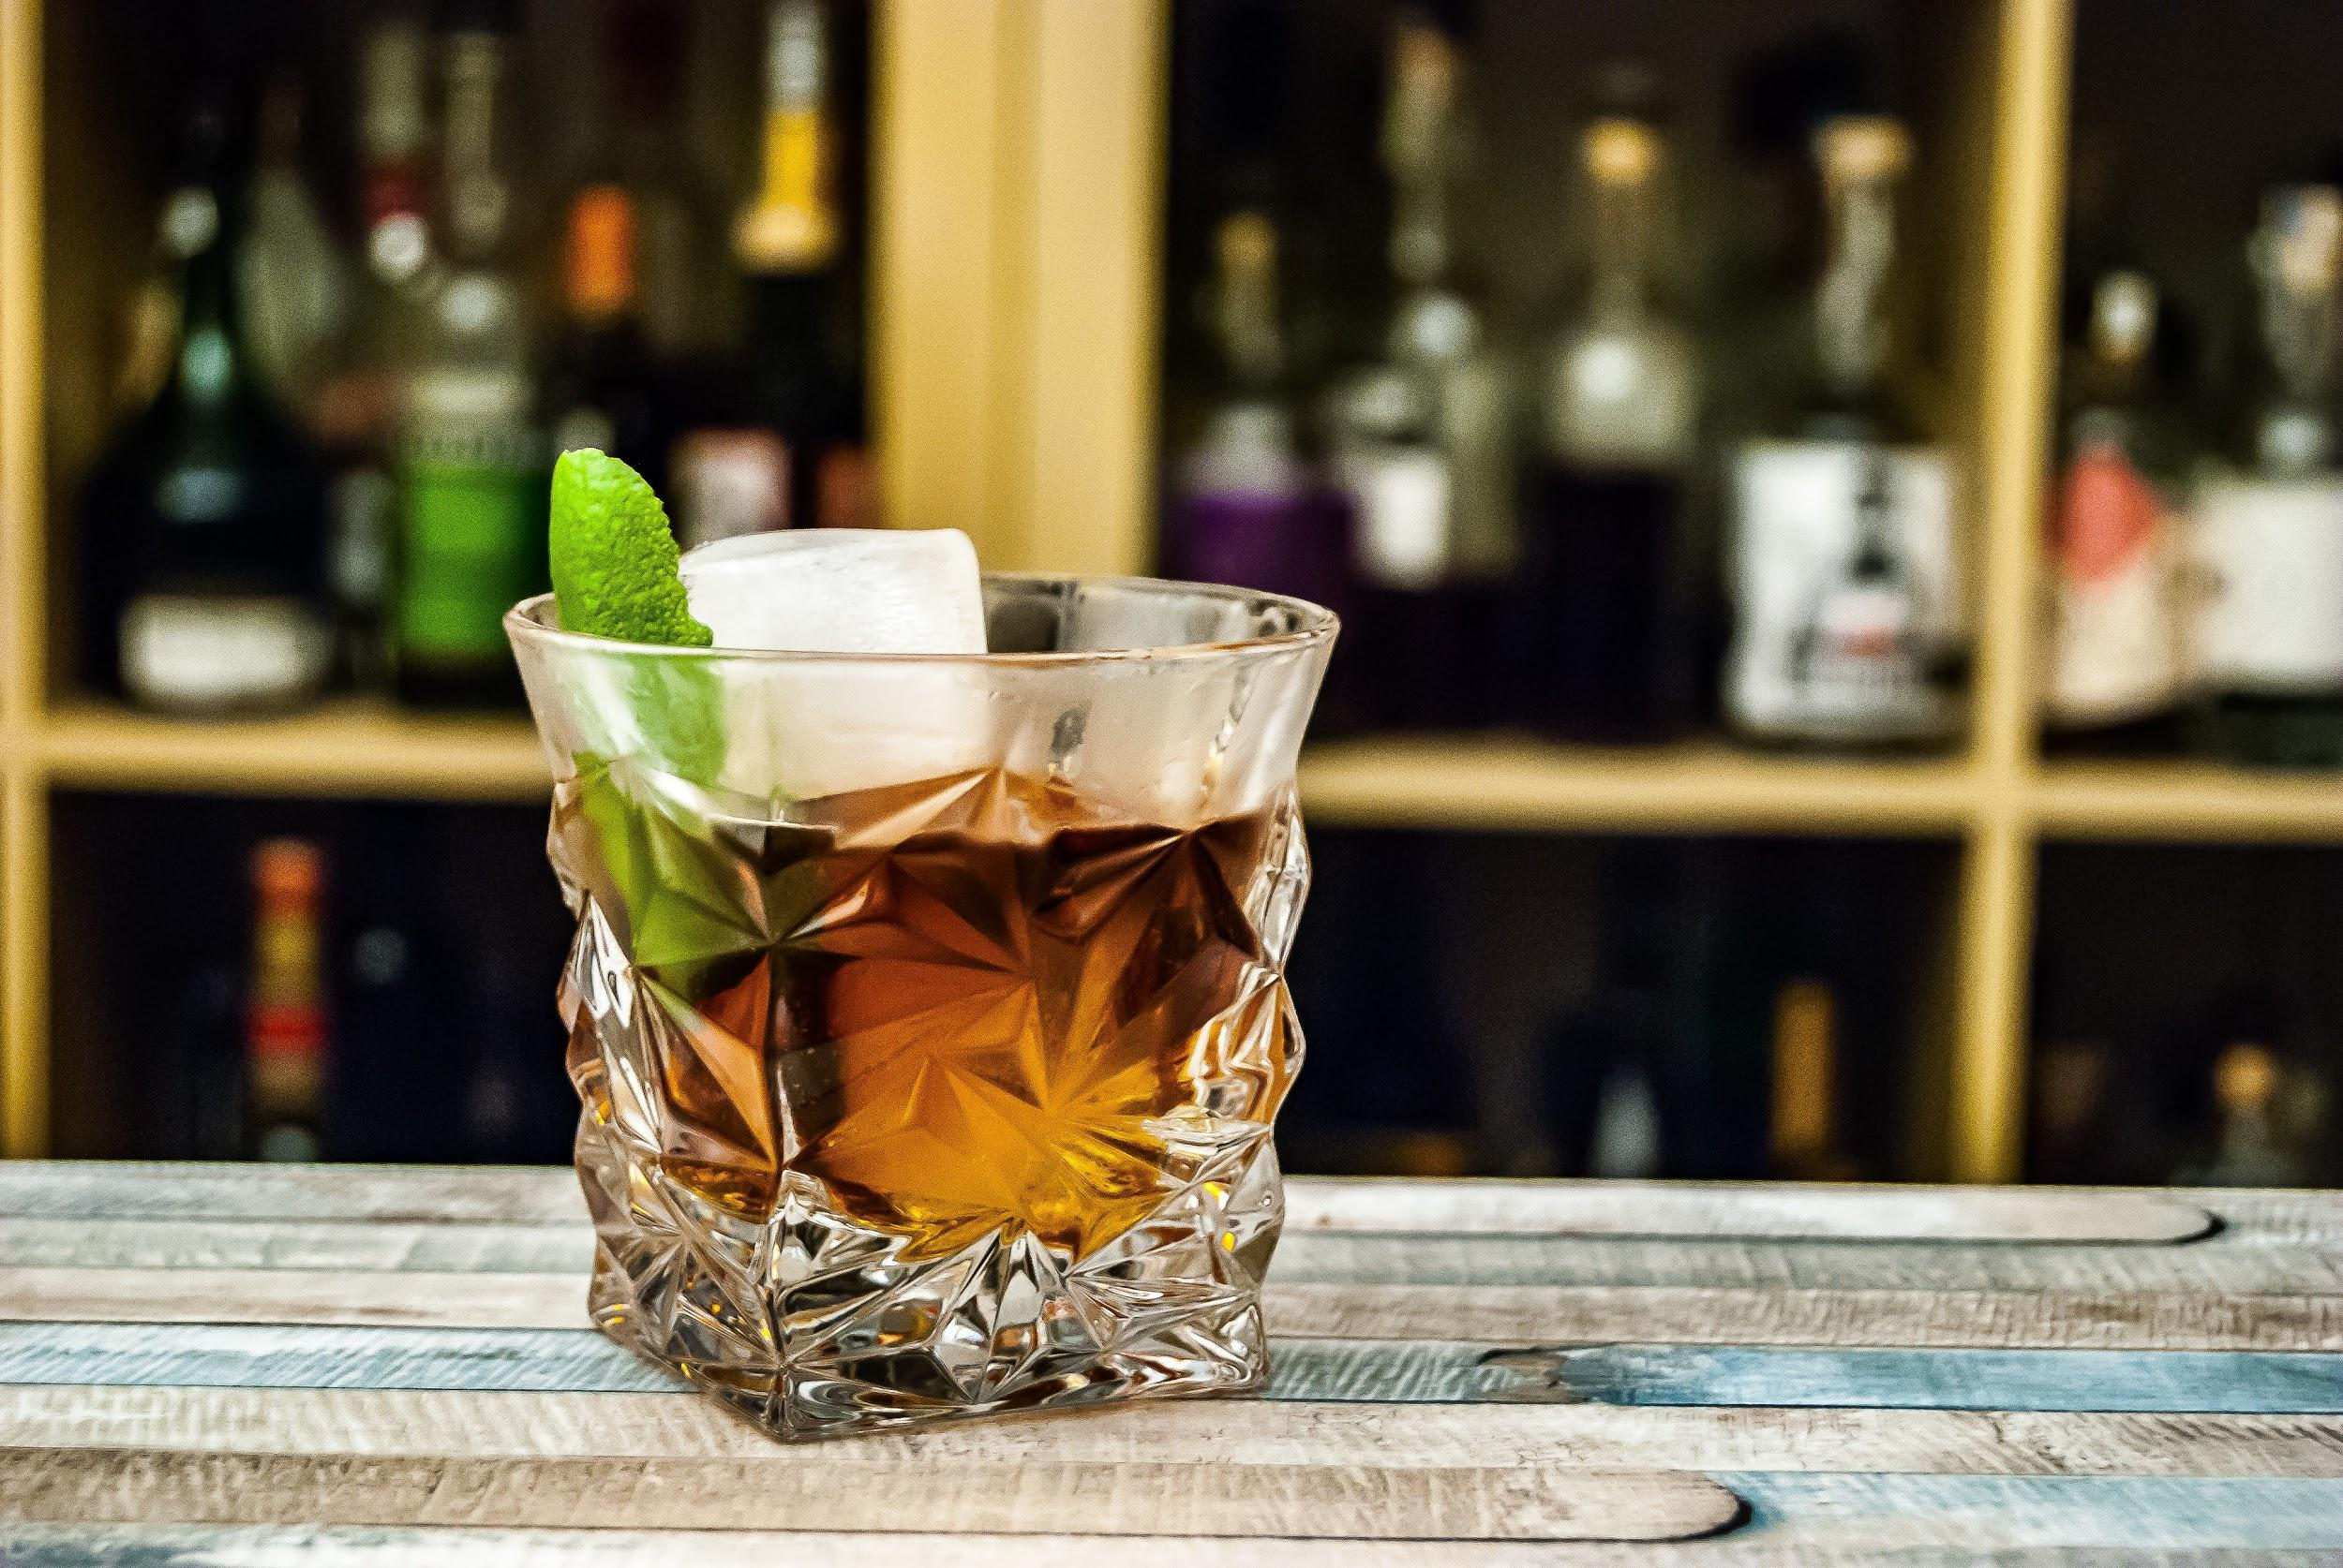
Rethink Your Drink - Activity
When you go out and order “one drink”, what exactly are you ordering? Do you know what the alcohol percent-to-ounce ratio is?
For each of the following drinks, write down how many ounces of alcohol are served in “one drink”, as well as what alcohol percentage is used.
One glass of wine
One shot of liquor
One glass of beer

Slide 14
Rethink Your Drink
When you are having “one drink”, that drink should be served under a standard drink size.
The United States has defined one standard drink as the following:
For wine, that would be 5 ounces of wine that contains about 12% alcohol.
For liquor, that would be 1.5 ounces of distilled spirits that contains about 40% alcohol.
For beer, that would be 12 ounces of regular beer that contains about 5% alcohol.
For malt liquor, that would be 8-9 ounces served in a 12 ounce glass that contains about 7% alcohol.
It is important to note that when drinking, it is encouraged to have no more than one standard sized drink per hour while consuming food and drinking water in between.
https://www.niaaa.nih.gov/what-standard-drink
Notes:
https://www.niaaa.nih.gov/what-standard-drink

Slide 15
Underage Drinking

Slide 16
“Underage drinking has numerous negative effects and consequences associated with it. Consuming alcohol underage not only damages the brain from fully developing, but it is also against the law and is the main contributing factor in vehicle collisions for persons between the ages of 16-20.”
https://www.abc.ca.gov/enforcement/underage-drinking/
Notes:
https://www.abc.ca.gov/enforcement/underage-drinking/

Slide 17
Question:
If you are under 21, what blood alcohol content (B.A.C.) would be considered illegal to drive?

Slide 18
Answer:
There is ZERO tolerance for those that are drinking and driving under the age of 21.

Slide 19
Underage Drinking
The legal drinking age in the United States is 21. Those under the age of 21 will not be allowed to legally purchase alcohol and can face consequences if caught drinking.
According to the Centers for Disease Control (CDC), alcohol is the most commonly used drug among youth in the U.S.
More than 4,300 deaths among people below the age of 21 occur each year in the U.S. due to excessive drinking.
Nearly 1,500 deaths are from motor vehicle crashes.
https://www.cdc.gov/alcohol/fact-sheets/minimum-legal-drinking-age.htm
Notes:
https://www.cdc.gov/alcohol/fact-sheets/minimum-legal-drinking-age.htm

Slide 20
Consequences of Underage Drinking
Possible consequences include:
Alters brain development
Higher risk for suicide and homicide
School problems
Higher absence rates
Poor or failing grades
Alcohol dependency later in life
Legal problems
Arrest for DUI
Alcohol-related car crashes and other unintentional injuries
Death from alcohol poisoning
https://www.cdc.gov/alcohol/fact-sheets/underage-drinking.htm
https://www.cdc.gov/alcohol/fact-sheets/minimum-legal-drinking-age.htm
Notes:
https://www.cdc.gov/alcohol/fact-sheets/underage-drinking.htm
https://www.cdc.gov/alcohol/fact-sheets/minimum-legal-drinking-age.htm

Slide 21
Binge Drinking

Slide 22
“Binge drinking is a serious but preventable public health problem.”
https://www.cdc.gov/alcohol/fact-sheets/binge-drinking.htm
Notes:
https://www.cdc.gov/alcohol/fact-sheets/binge-drinking.htm

Slide 23
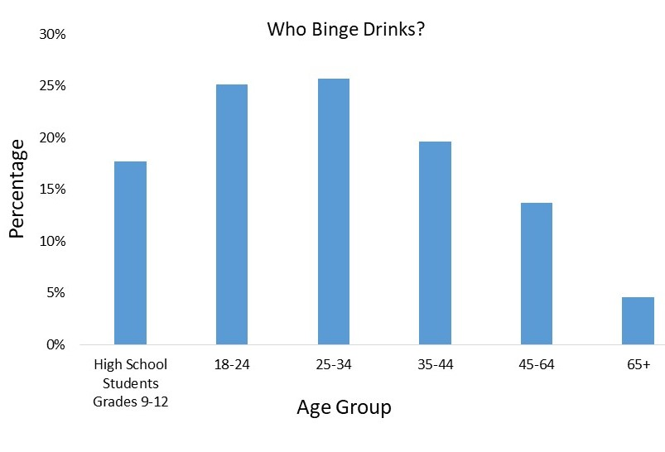
Binge Drinking
According to the CDC, binge drinking is when a person’s B.A.C. (Blood Alcohol Content) reaches .08 percent or higher.
For men, this generally occurs after having 5 or more drinks.
For women, this generally occurs after having 4 or more drinks.
The most affected age range is 18 - 34 year olds.
https://www.cdc.gov/alcohol/fact-sheets/binge-drinking.htm
Notes:
https://www.cdc.gov/alcohol/fact-sheets/binge-drinking.htm

Slide 24
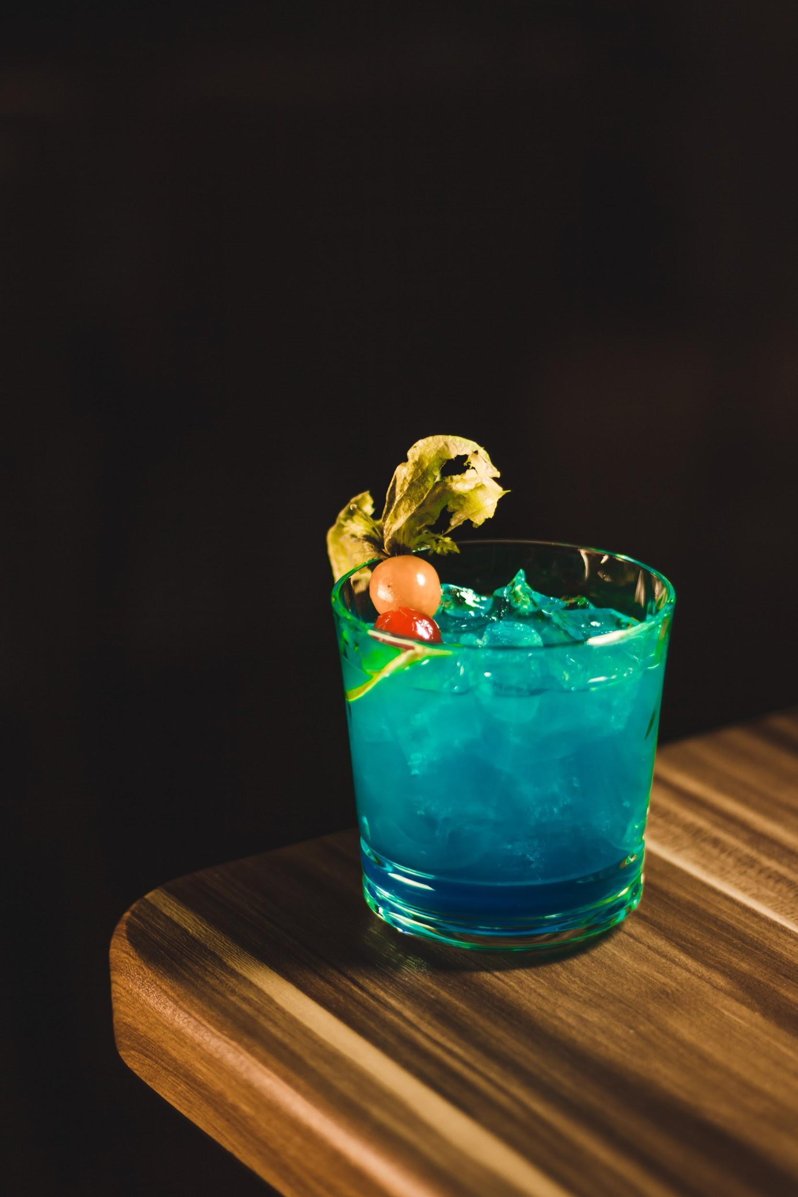
Binge Drinking - Why is this a problem?
Not all drinks are made the same!
Some drinks will contain higher percentages of alcohol than others.
Drinks can look deceiving!
Just because a double shot looks smaller than a glass of beer doesn’t mean that it contains less alcohol.
When people don’t understand standard drink sizes or how to drink responsibly, it becomes easier to overdrink.

Slide 25
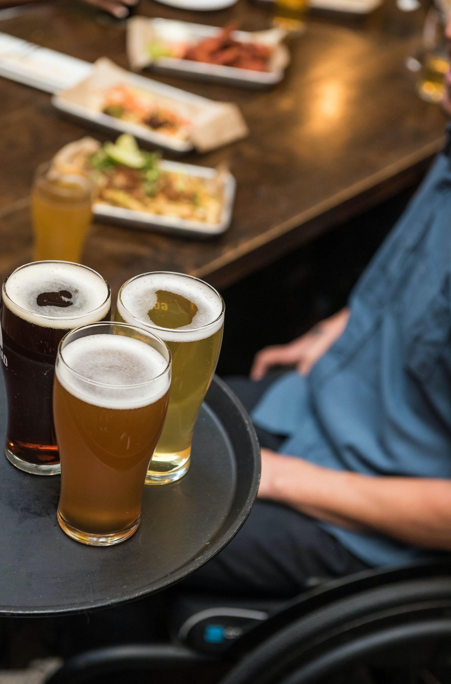
Drinking on Campus
Many college campuses have eateries that sell alcohol on campus. Studies estimate that nearly 70% of college students consume alcohol, but of those, 26% reported binge drinking only one time in the last two weeks, while 30% of all students have never had an alcoholic drink in their life.
Campus events, sporting events, greek life activities, and having access to alcohol through on campus eateries may influence alcohol consumption. Visit your college website to find out more about your campus alcohol policy.
However...
Most college students are doing the right thing by avoiding binge drinking (65%), and avoiding impaired driving (80%), plus they are overwhelmingly using alternative transportation from trams to rideshare. If you see someone who isn’t, be a friend and speak up or take action.
FRIENDS DON’T LET FRIENDS DRIVE DRUNK… DO YOU? ®
ACHA-NCHA III, Fall 2019 - Present.
Notes:
ACHA-NCHA III, Fall 2019 - Present.

Slide 26
House Parties
Social Host Ordinances are different in every county.
In San Diego county, if you are hosting a party on property owned, leased, or controlled by adults, in which you know minors are being provided alcohol, you are considered a “Social Host”.
As a “Social Host”, it is your responsibility to verify the age of your guests, monitor minors, and have access control over alcohol being served to guests that are underage. Not only is this your responsibility, but it is required.
If there is underage drinking, you will be held accountable and may face consequences such as:
Being cited or arrested
Paying a fine of up to $1,000+
Serving up to six months in jail
https://www.sdsheriff.net/social-host/
Notes:
https://www.sdsheriff.net/social-host/

Slide 27
Wrap Up
By completing this lesson, you should have an understanding of how alcohol gets absorbed into the body and what factors can influence the rate of absorption, what a standard drink size is in the U.S., what binge drinking and underage drinking is, campus alcohol policies, and what the Social Ordinance rule is.
Now that you have completed this lesson, head over to Lesson 2: Driving Under the Influence to learn about how getting a DUI will affect you.

Slide 28
Knowledge Check
Please click on the following link to test your knowledge on this lesson,
Alcohol Consumption.
(Link will be placed here with survey questions. See attached Q/A document.)

Slide 29
For More Information
Please contact:
(SoCal) Marian Novak: marian@radd.org
(NorCal) Lindsey Peters: lindsey.peters@radd.org
Or visit www.RADD.org

Slide 30
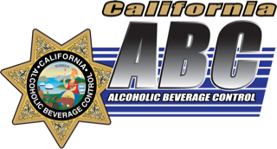
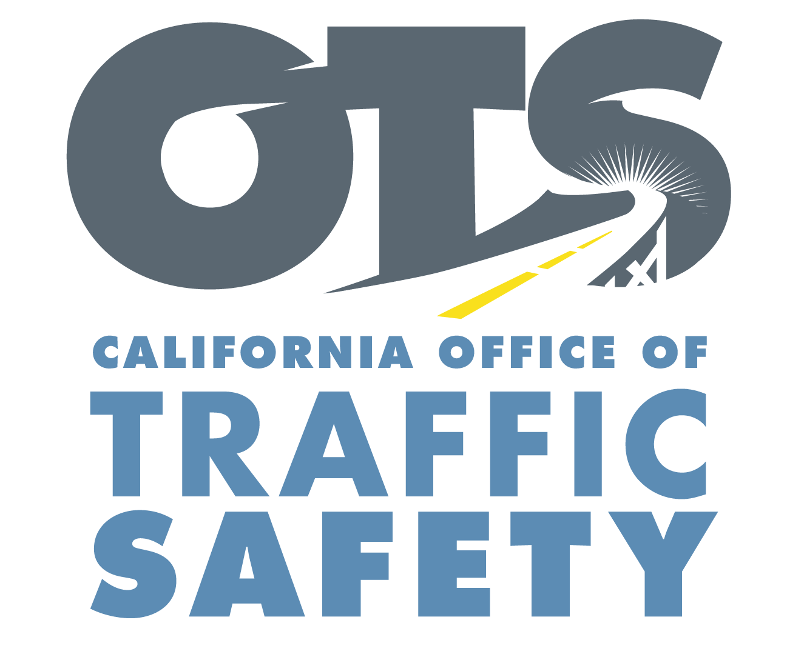
Funding for this program was provided by a grant from the California Office of Traffic Safety,
through the National Highway Traffic Safety Administration.

